Slide 1

Nicos Starreveld
Communication and outreach officer

Slide 2
2014 - 2018 Research at the UvA in probability theory, operation research, random graphs.
2018 – 2024 Teacher in the bachelor of mathematics of the UvA.
2018 – 2024 Coordinator of science Communication at NETWORKS.
Sept -… Communication and Outreach at Platform Wiskunde Nederland

Slide 3
A central institution within Dutch Mathematics so that all relevant matters can be managed effectively.

Slide 4
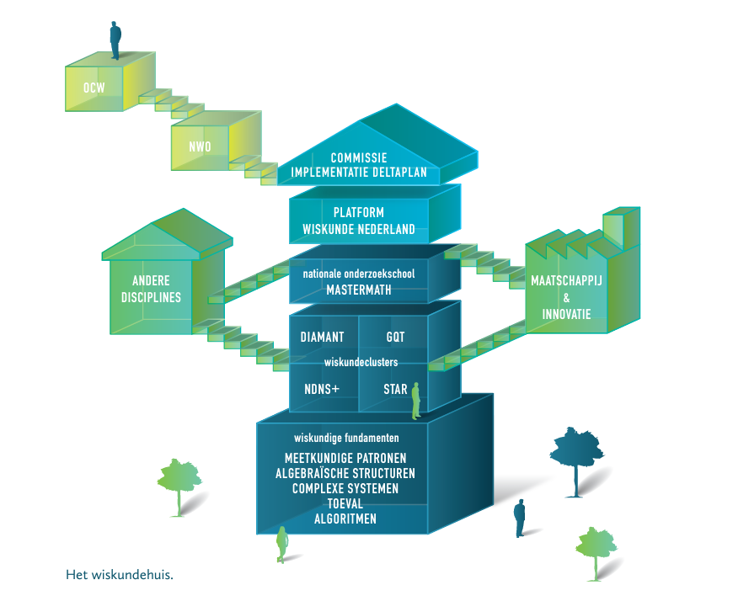

Slide 5
Goal is to strengthen the
financial,
administrative,
scientific and
public
position of mathematics research and mathematics education in the Netherlands.

Slide 6
Five committees
research
education
innovation
publications
publicity

Slide 7
Participates actively in policy making.
Finances initiatives that support Dutch mathematics.
Initiates collaborations with industry and society.
Advertises mathematics to the public and the press.
Supports community building.

Slide 8


Slide 9
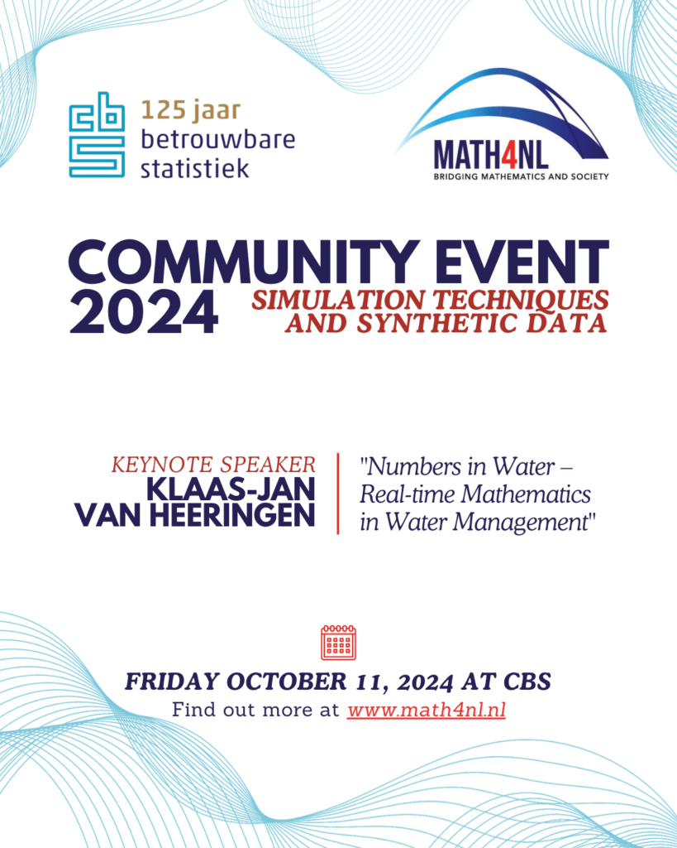
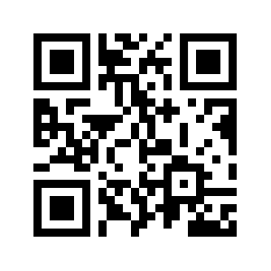
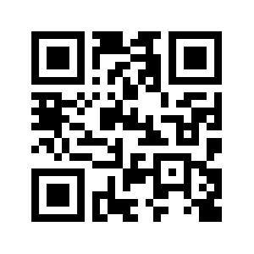



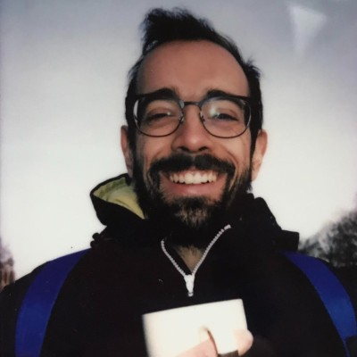
PWN website
www.platformwiskunde.nl
PWN newsletter

