Slide 1
A History of Computational Aerodynamics Philip Roe Department of Aerospace Engineering University of Michigan
Woudschoten Conference
7 - 9 October 2015, Zeist

Slide 2
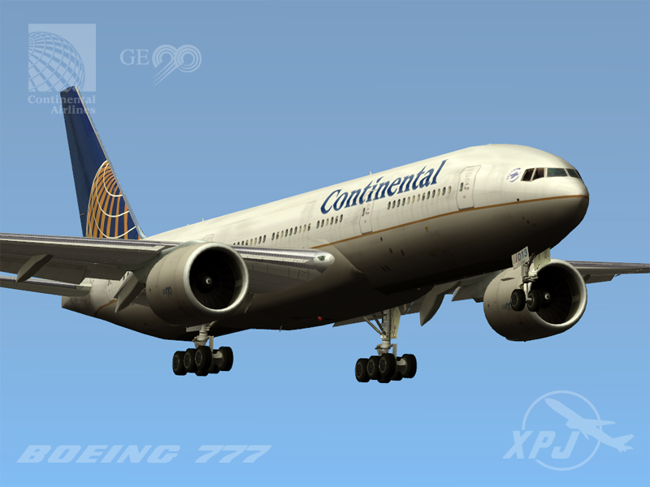
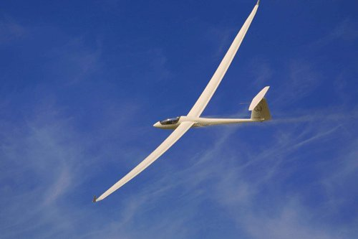
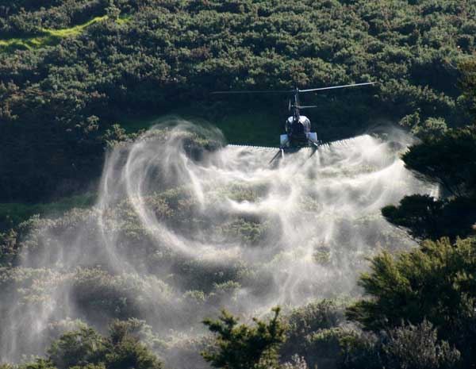
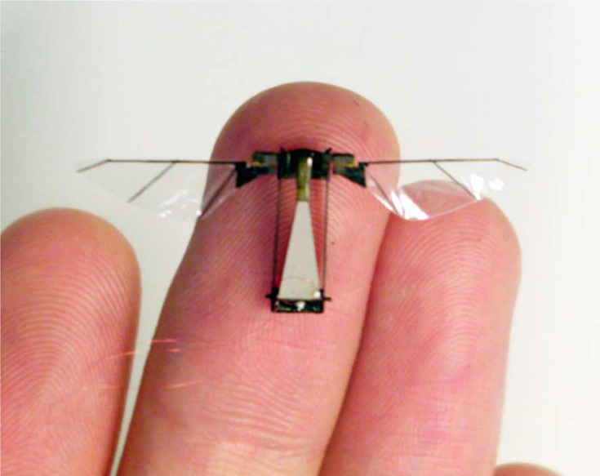
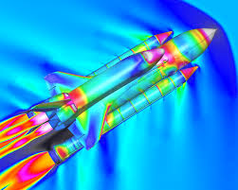

Slide 3
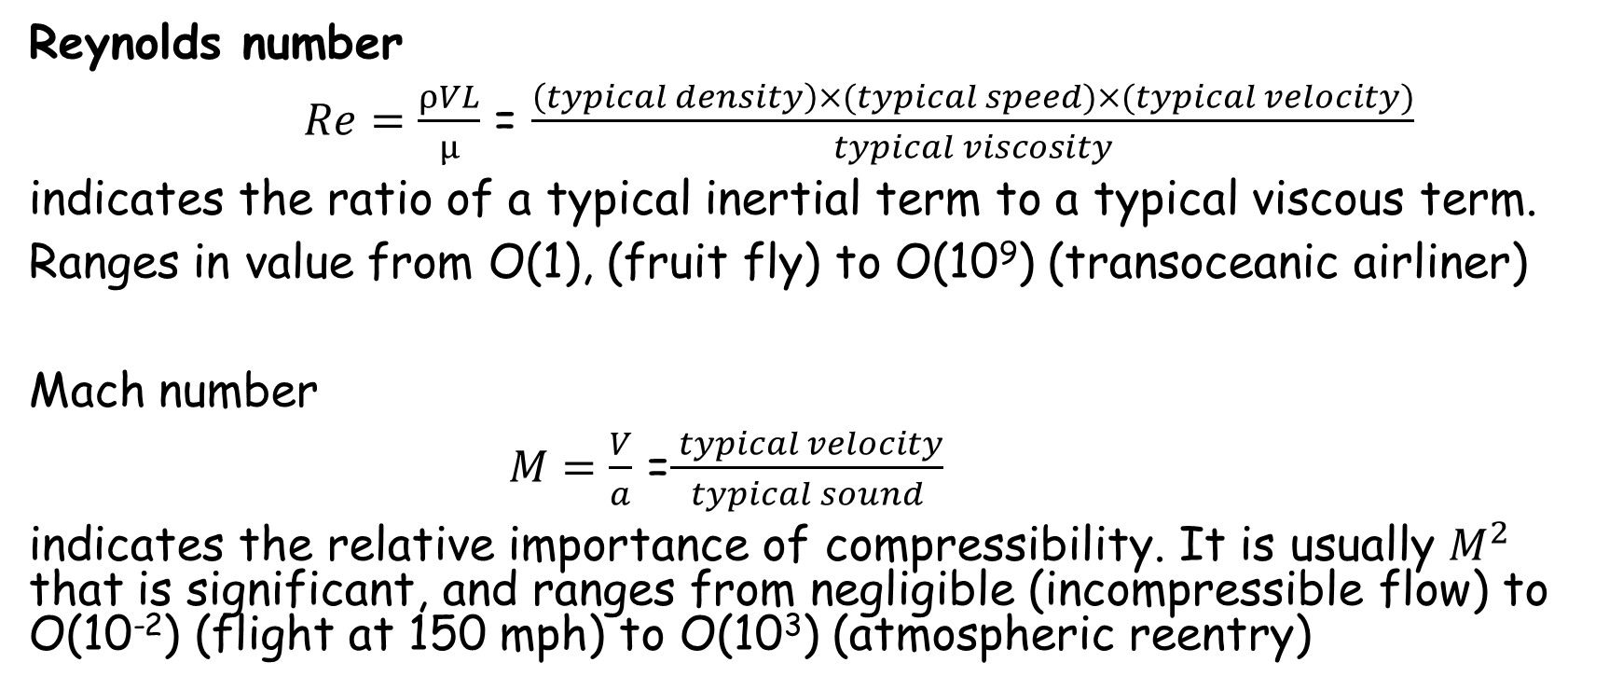
Basic parameters
Reynolds number
$Re=\frac{ρVL}{μ}$ = $\frac{\left(typical density\right)×(typical speed)×(typical velocity)}{typical viscosity}$
indicates the ratio of a typical inertial term to a typical viscous term.
Ranges in value from O(1), (fruit fly) to O(10⁹) (transoceanic airliner)
Mach number
$M=\frac{V}{a}$ =$\frac{ typical velocity}{ typical sound }$
indicates the relative importance of compressibility. It is usually $M^{2}$ that is significant, and ranges from negligible (incompressible flow) to O(10⁻²) (flight at 150 mph) to O(10³) (atmospheric reentry)
Notes:
M^2 is a ratio between two kinds of energy.

Slide 4
Aerodynamics is easy because…
Air is an extremely simple substance
Efficiency in fluid flows goes hand-in-hand with
simplicity

Slide 5
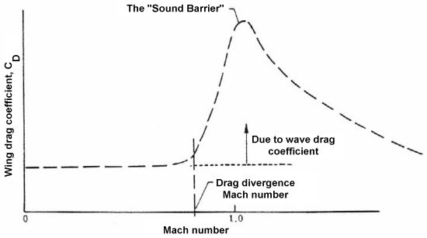
Aerodynamics is hard because……..
Competition takes place at the margins. An increase of one percent in the drag of a typical airliner requires that 7-8 passengers be thrown off to accommodate the additional fuel.
The best operating point
coincides with the onset
of significant nonlinearity.
o
Notes:
Passenger flight is 8% of US GDP

Slide 6
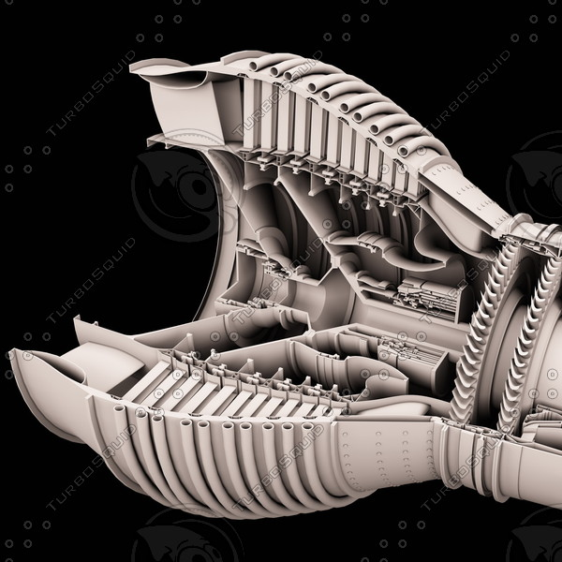
Aerodynamics is hard because……..
Geometry is complex and also very important. There is little value in generic explanations. This puts great stress on grid generation. Unstructured tetrahedral grids are (relatively) easy to generate automatically.
Compressor stage of Rolls Royce Trent turbo jet

Slide 7
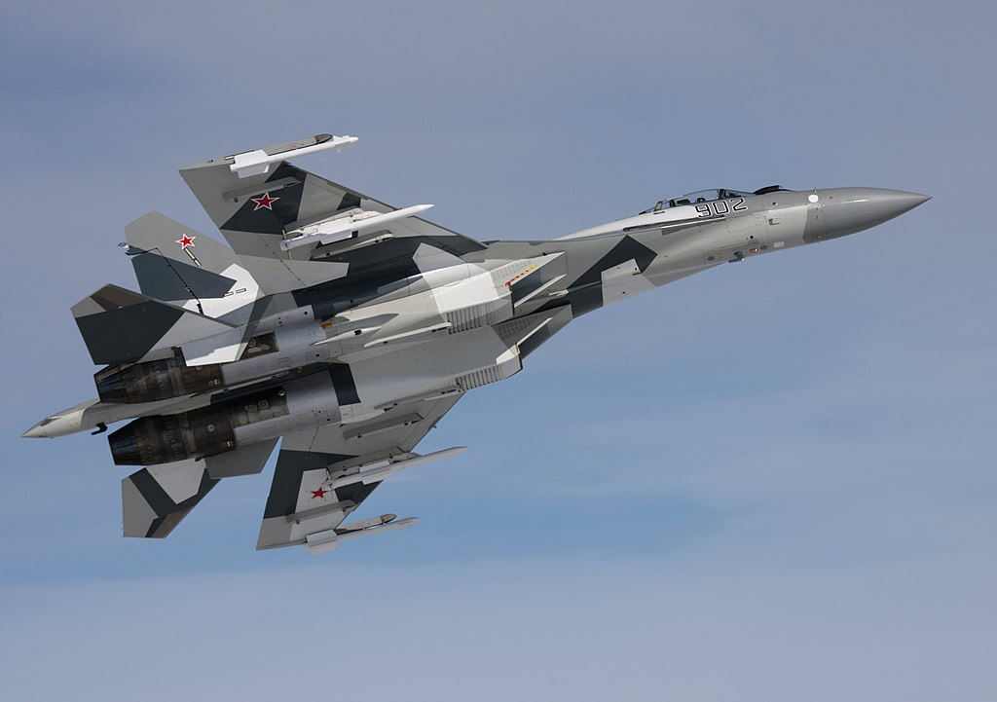
Aerodynamics is hard because………
military aircraft become cluttered with
weapons (geometry again) and attempt wild maneuvers under extreme conditions. It takes a long time and a great deal of
money to produce a new combat aircraft. CFD is looked to in both respects.

Slide 8
Aerodynamics is hard because …
of turbulence which is a fractal phenomenon involving similar events being repeated at successively smaller scales.
Yokokawa, Itakura, Uno, Ishikara, ACM/IEEE, 2002

Slide 9
Aerodynamics is hard because it is easy!
In many problems from other areas the geometry or the material properties may be unknown. There is little point to making the simulations more accurate than the data. Often in aerodynamics the numerical errors dominate.
There is nothing to hide behind!

Slide 10
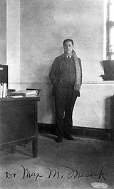
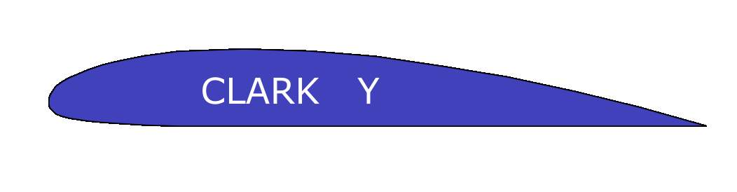
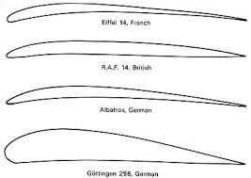

The Wright brothers….. Had no reliable theory of flight to guide them, largely for lack of a useable mathematical model. The Navier-Stokes equations were known but much too complicated to solve. Simplifications were not trusted-Neglecting viscosity and rotation gives a potential flow that predicts zero resistance. Early designers used crude experiments and analogies from natural flight. They placed no reliance on what theory there was.
M. M. Munk, 1922

Slide 11
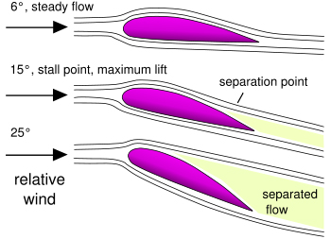
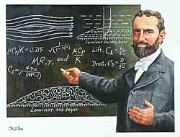
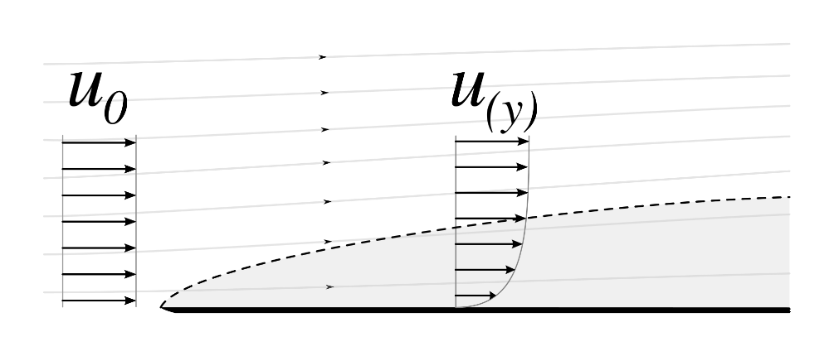
Avoiding the Navier-Stokes equations
The enabling insight of Ludwig Prandtl in 1904 (but not recognized until much later) was that in all real flows there is a layer of slow-moving air near the surface (the boundary layer) On a typical airliner the wing boundary layer is measured in millimeters. Provided the boundary layer remains thin and adjacent to the surface it causes little change to the outer flow.
Shapes for which this is likely are called streamlined shapes.

Slide 12
Aerodynamics is hard because
The aircraft industry, in all its aspects, is highly competitive. Competition takes the form of flying closer to the limits of speed, size, maneuvrabilty, and control. Calculations are required to be accurate under extreme conditions. Most manufacturers use code that is developed in-house. They only describe it in very general terms.
Aerodynamics is hard because
Design is not optimization. No single figure of merit can capture excellence in all of the relevant measures. Only fast and flexible feedback can guide the designer to good choices.

Slide 13
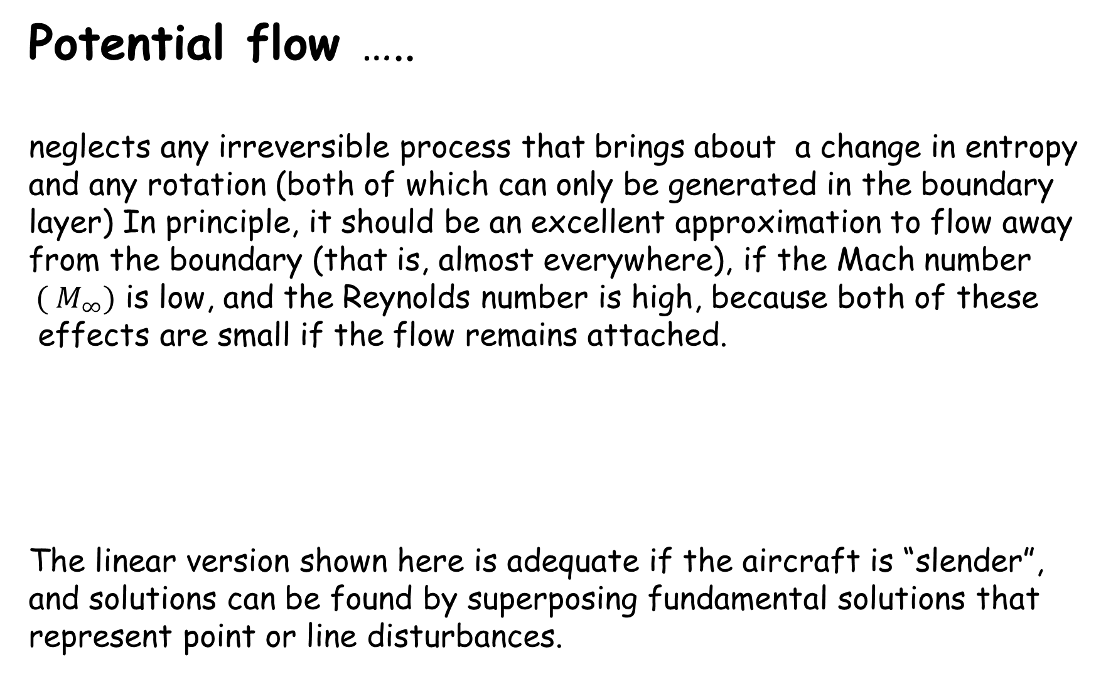
Potential flow …..
neglects any irreversible process that brings about a change in entropy
and any rotation (both of which can only be generated in the boundary
layer) In principle, it should be an excellent approximation to flow away from the boundary (that is, almost everywhere), if the Mach number
${ ( M}_{∞})$ is low, and the Reynolds number is high, because both of these effects are small if the flow remains attached.
The linear version shown here is adequate if the aircraft is “slender”,
and solutions can be found by superposing fundamental solutions that
represent point or line disturbances.
Notes:
Minfty is the Mach number of the aircraft relative to atmosphere ar rest. A linear transformation yields laplace equation. Components such as wings and bodies were often designed in isolation and checked in wind tunnels.

Slide 14
Panel methods…..
Place distributions of sources/sinks/vortices with undetermined
coefficients over each panel and solve a set of linear equations
to enforce the condition of no normal velocity at a set of control
points. Their main usefulness was to suggest and guide wind-tunnel
experiments, but they are still in use to guide CFD.

Slide 15
Flow close to the surface ….
is handled by the boundary layer equations, that accept as given the surface pressures predicted for the outer flow, and describe how the boundary layer responds.
The boundary layer creates a displacement surface that alters the effective shape of the aircraft, and therefore the pressure distribution.
In principle, we should iterate these steps, but in practice the displacement surface is so thin that we do not bother to correct the pressures.

Slide 16

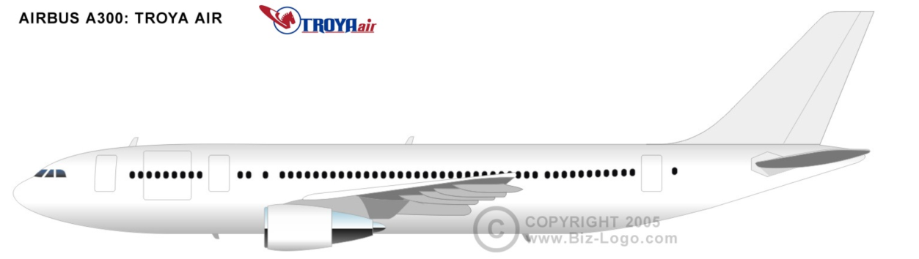
The battle of the Atlantic
Boeing 747. Entered service 1970 Boeing 747-300 1983
Airbus 300. Entered service 1974 Airbus 310 1979

Slide 17
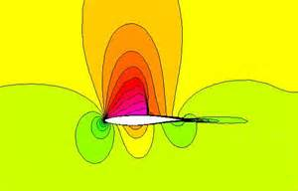
This is the problem
that everyone wanted to solve, the flow over a two-dimensional slice of
the wing. The governing equations are of mixed type. This is a modern
solution of the Euler equations
Shock wave
Supersonic region
Notes:
Shock produced drag through irreversibility and separation. Could it be eliminated.

Slide 18
The next step up…..
Goes to the nonlinear potential equation. This again neglects
irreversible and rotational effects, but does not assume small
perturbations. It can be shown that these are proportional to the third power of the shock strength, and so the model should be valid. But
at the and of the 1960s the computers were not yet powerful enough.

Slide 19
So step back down again..
To retaining only the most important nonlinear term
and solve using finite differences on a rectangular grid with boundary
conditions applied on y=constant. The bracket is positive for subsonic flow (resembling Laplaces equation) indicating that information can flow both ways but negative for subsonic flow (resembling the wave equation).
In the linear case, the signs are the same throughout the flow.
Notes:
A fluid and a computer are both information-processing devices

Slide 20

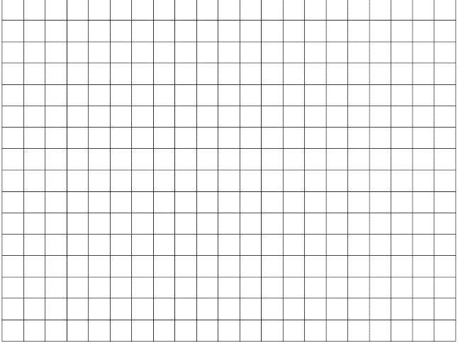
‘Type-dependent differencing’…
The finite-difference ‘stencil’ is chosen to mimic the local flow of information
Notes:
Phi_x greater or less than local speed of sound

Slide 22
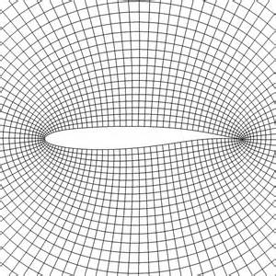
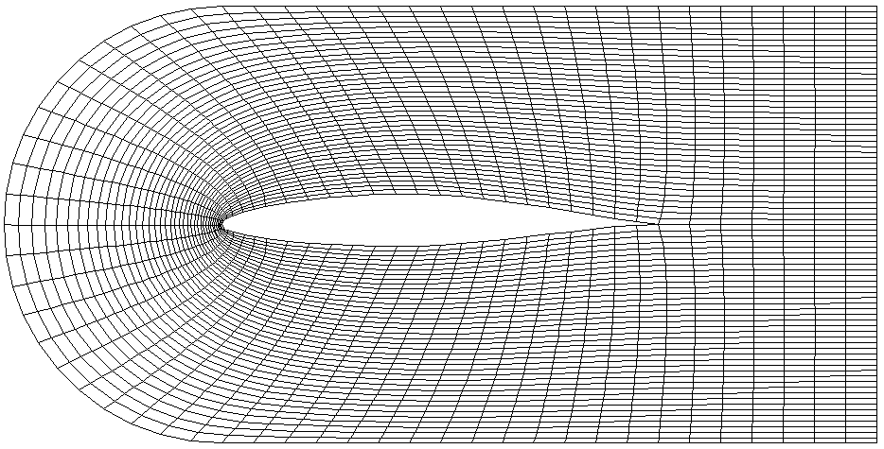
The computational grids….
came to be ‘body-fitted’ to facilitate the accurate enforcement of boundary conditions, but remained logically rectangular to be compatible with an (i,j) array structure. The grids were required to be smooth but also to be clustered in regions of rapidly-varying flow.
It seemed far from obvious how to evaluate derivatives on such grids.

Slide 23
The potential equation
Is not capable of modeling every aspect of a shockwave with equal fidelity (because it neglects entropy changes) so disputes arose over just which aspects were most important.
The German mathematical society GAMM (Gesellschaft für Angewandte Mathematik und Mechanik) had begun to organize biannual CFD conferences, starting in 1975, and now undertook to hold a workshop in Stockholm in 1979, where leading researchers could meet to compare their solutions to a set of agreed test cases for transonic flow over two-dimensional airfoils. The meeting became known as the Stockholm Olympics.
Notes:
Could conserve mass and momentum but not both. Conservation of energy is not possible.

Slide 24
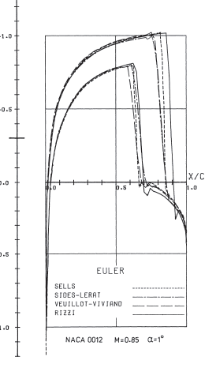
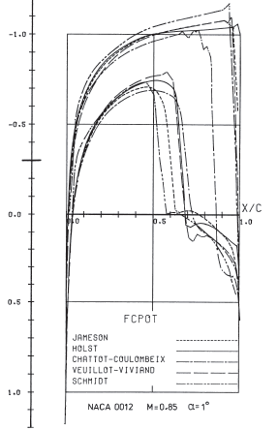
The outcome was devastating!
Conservative potential Nonconservative potential Euler
Notes:
Curves are negative upward! So that area beteween is lift. Location of shock is very important

Slide 25
Scatter was huge!
Drag Lift
(The results that I contributed to have gold stars)
As a result of the Stockholm Olympics, the use of potential theory for transonic drag prediction was almost completely abandoned.
Notes:
But what had gone wrong? Pressure needs to be changed by less than one percent to fly.

Slide 26

The potential flow model….. is justified theoretically by the fact that the neglected irreversibility of the shockwave is of the order of the cube of the shock strength (and so the cube of the drag resistance, which is the thing that we are trying to keep small) However, there is no geometrical feature to keep the shock at any particular location on the surface. The location, and therefore the strength, is decided by a very subtle balance of forces. The Stockholm Olympics sounded the death knell for potential flow as a model for transonic aerodynamics
Notes:
Where does the shock choose to sit and why? To equalize pressure at the trailing edge.

Slide 27
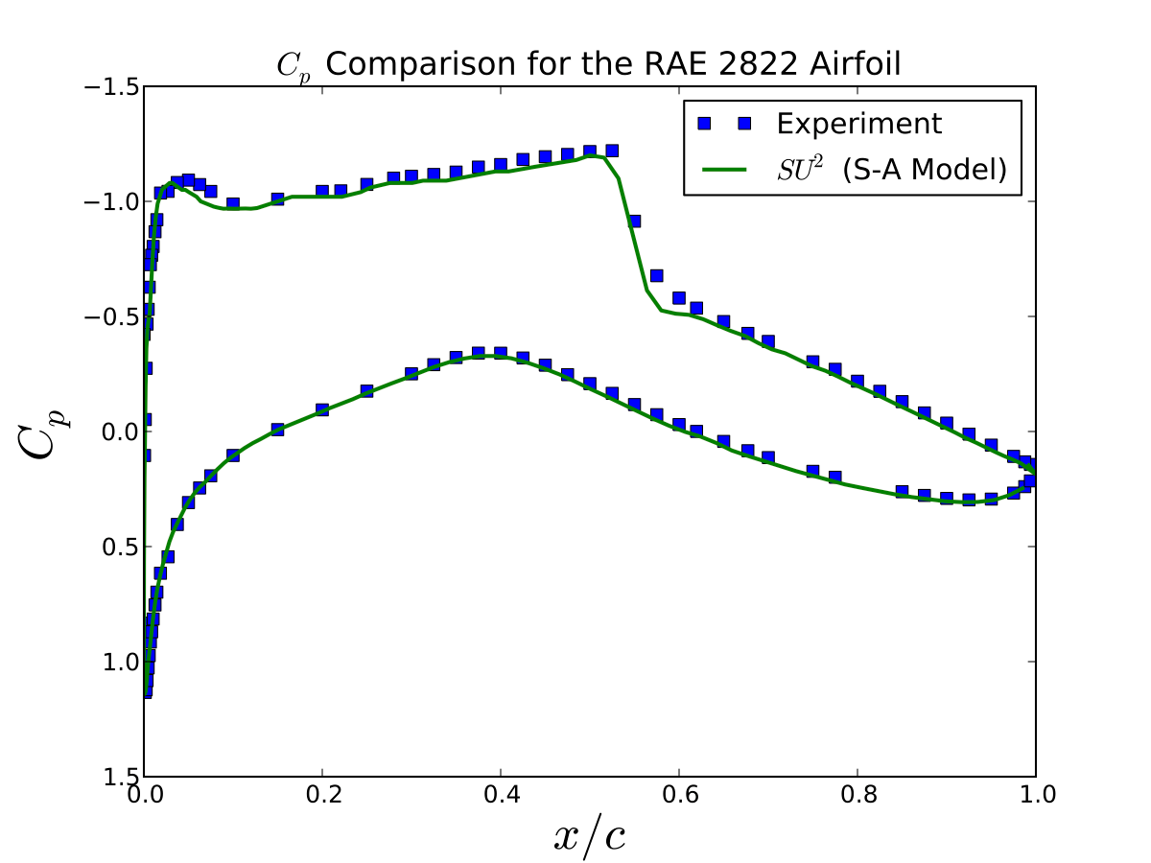
Things have got a lot better, by the way
Notes:
This is NS compared to experiment.

Slide 28
The finite-volume approach
Finite differences are hard to implement on a curved grid, and generally do not enforce conservation.
A better approach is to divide the space into boxes, each containing a certain amount of mass, momentum and energy. A “flux” through each face transfers some of each from one cell to a neighbor, so that nothing is lost.
This works even when the flow contains shockwaves and the derivatives do not exist.
Notes:
Use All concepts. Ensure conservation by FV but calculate flux from FD. At tention switches to flux prediction.Aero engineers fought against complicating the math model.

Slide 29
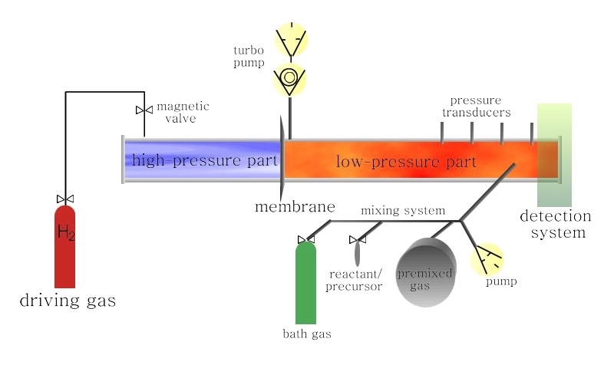
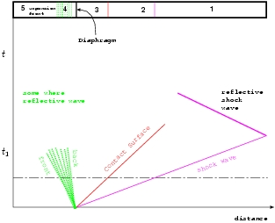
A step sideways-the shocktube fiasco
The shock tube is a common way to generate a brief high-speed flow to conduct experiments. It is also a common way to test the ability of a CFD code to capture shockwaves.
Because this is a one-dimensional problem, it should be easy, but in 1979, almost no method was capable of giving a reasonable solution.

Slide 30

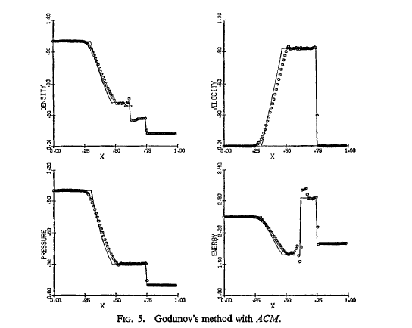
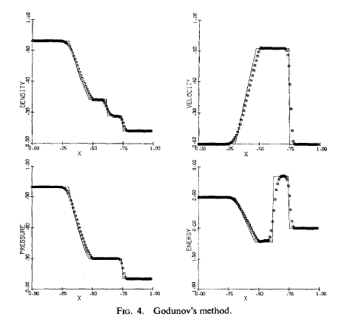
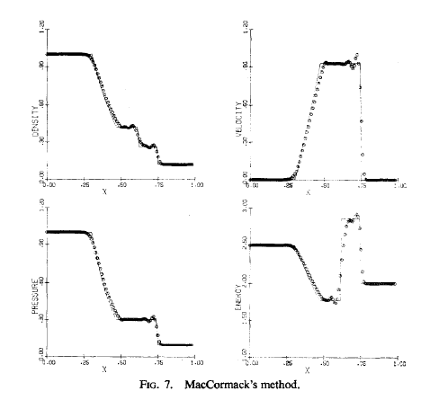
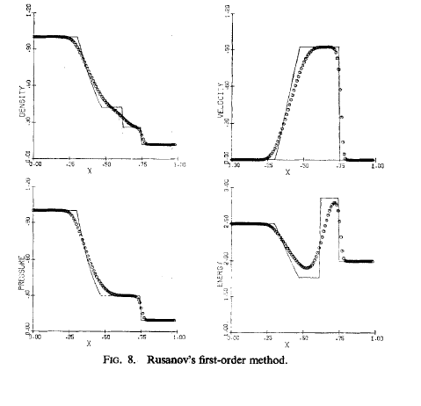
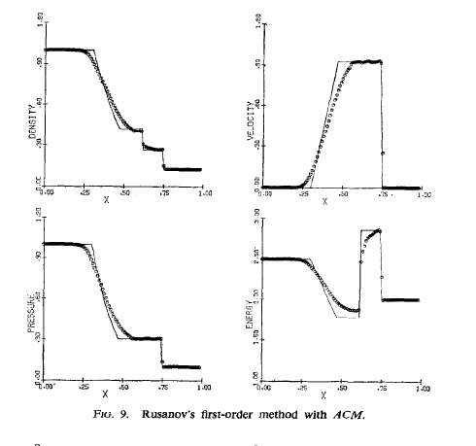
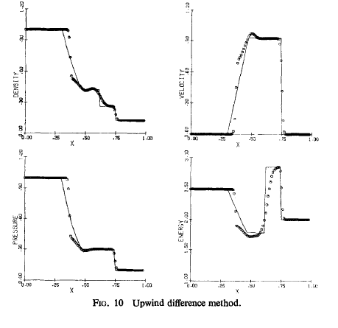

Slide 31
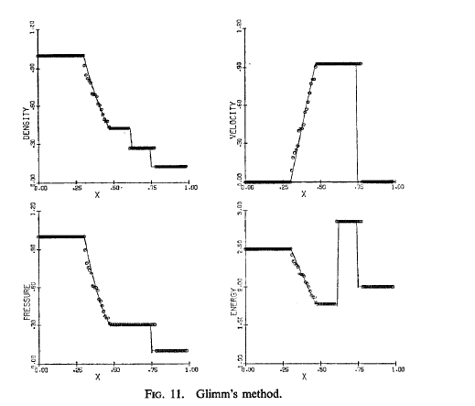
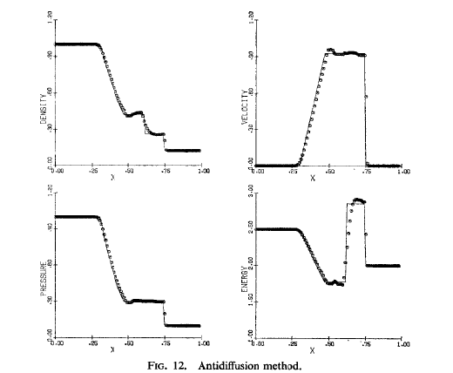
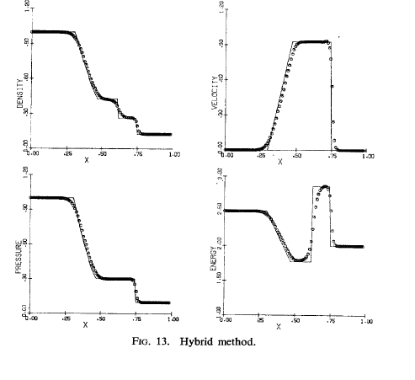
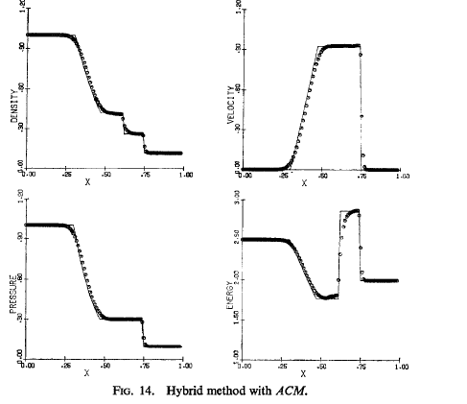
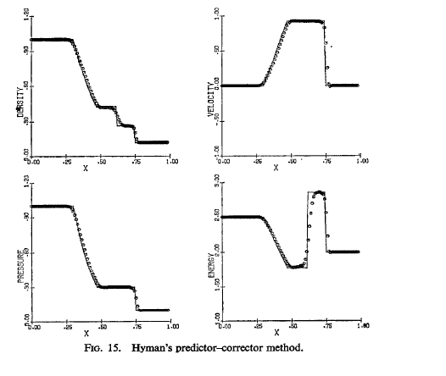
…and a few more
Sod’s shock tube has become the “entry level” test for new CFD algorithms

Slide 32
The Godunov method…
Uses the shock-tube problem as inspiration rather than test.
Replace the actual data within each cell by the average density,momentum, energy that it contains. The data is now piecewise constant in cells. At every interface, the two constant states define a “Riemann problem.”
The real data is (a) whose evolution we wish to approximate.
The approximate data is (b) whose exact evolution we can calculate for a small time Δt.
Now approximate the new solution.
The error in this will be O(h)
(a)
(b)
h
Notes:
This is 1959!! Greatest total citations with slowest start. Replay of math vs engineers.

Slide 33
The 2nd-order Godunov method reconstructs
the data in each cell by adding a locally constant gradient. The resulting function is not C⁰ This is very important because the solution may actually be discontinuous. The update procedure is a little more complicated and the error in the method is now 0(h²).
Assigning the gradients must be done carefully. A safe choice is to take slightly more than the smaller option.
Notes:
Godunov paper largely ignored. Obscure Russian math journal. Use FD to find flux but there are now terms involving the interior. In the multidimensional case only consider variation in the normal direction.

Slide 34
The Riemann problem …….
can be solved for ideal gas dynamics) by a fast iterative process (we solve two nonlinear algebraic equations) but initially even this extra cost deterred people from following this approach. Approximate direct solutions were found, and called ‘approximate Riemann solvers’ (Roe, Osher, van Leer, Liou and others)
There is a compromise to be reached between accuracy and cost. Since the problem posed is artificial we might expect cost to be most important. It has turned that too much simplification is bad. The solver must be able to detect different kinds of physics. For an inviscid fluid there are only two; convection and sound waves (acoustics). The first travels with the fluid, but the second travels through the fluid.
Exact solution
(Over) simplified solution

Slide 35
A simple but discriminating test
is to consider the supersonic flow past a circular cone enveloped by a thin boundary layer. Methods that do not correctly account for density differences (carried convectivly) need many more points to resolve the boundary layer. They are no longrr in general use.
.
Van Leer, Thomas, Roe and Newsome, AIAA paper 1987-1104

Slide 36
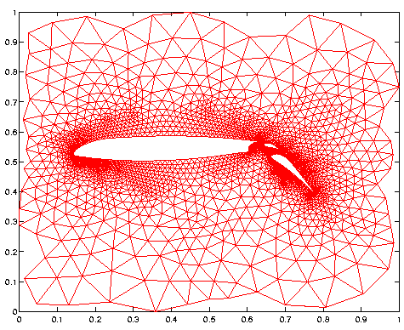
Unstructured grids….
Are usually formed from triangular or tetrahedral elements. These
give rise to simple formulas and are easy to fit into awkward corners. They can be generated automatically and are easier to “refine” in regions of complex flow.
They have a reputation for lower accuracy and often hybrid grids are created

Slide 37
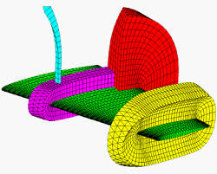
This ‘prismatic’ grid
is formed from the triangulated CAD description of the surface shape by outward extrusion to beyond the anticipated boundary layer.
This provides greater accuracy in a critical region. Beyond this a set of unstructured tetrahedral are formed automatically by growing a series of layers.
The grid is improved by a ‘smoothing’ operation, e.g. moving each point toward the centroid of its neighbors.

Slide 38
Time-marching
is almost always carried out by discretizing in space only, to obtain a set of ordinary differential equations. These are solved used RK4 or something similar. Special
properties of ODE solvers are not generally required, but one original twist has been found worthwhile.
Suppose that we require some property such as positive density to be preserved, and it actually is observed by our intended spatial discretization combined with Forward Euler timesteppping. Then any ODE solver that can be rearranged as a sequence of Forward Euler steps with positive Δt will also preserve that property, and is said to be strong stability preserving. There is by now a substantial literature on SSP methods.

Slide 39
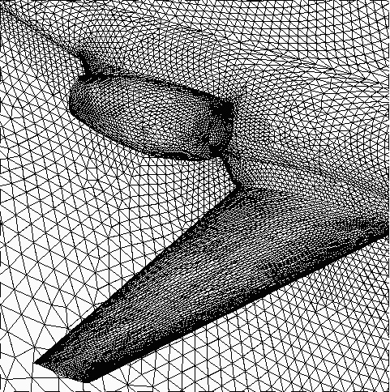
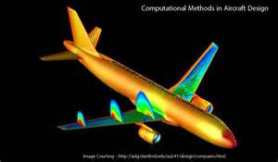
Current CFD Capability…..
Derives from the algorithms I have described, which have undergone only minor changes since 1990. It is felt to be adequate for clean configurations under steady cruising conditions. It is felt to be capable of improvement for more complex geometry and more extreme flows, especially those involving flow separation, but it is the most advanced method currently used in industry.

Slide 40
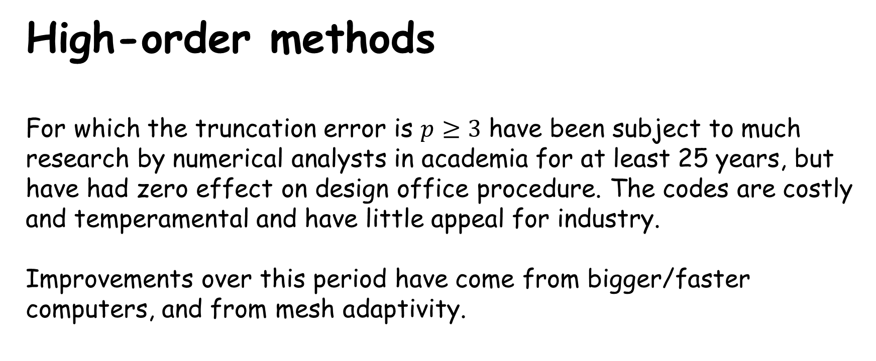
High-order methods
For which the truncation error is $p≥3$ have been subject to much
research by numerical analysts in academia for at least 25 years, but have had zero effect on design office procedure. The codes are costly and temperamental and have little appeal for industry.
Improvements over this period have come from bigger/faster computers, and from mesh adaptivity.

Slide 41
Improving the mesh
An aspect that has developed is the computational mesh. The expression for local error is
A plausible heuristic is to make the error equal everywhere. That is to say, h should be small wherever the derivatives are large. In practice, since the derivatives can only be estimated anyway, just the first derivative may be considered, and refinement carried out any place where large jumps in pressure or velocity were found.

Slide 42
CFD for a purpose
An important question to ask about numerical error is whether that error matters for the purpose of that computation.
This can be made formal. Suppose that we are interested in the value of some particular output, J, such as the drag. We can ask how sensitive the drag would be to an error made at a particular place in a particular quantity (density, momentum, energy, say) We assume that these errors are not random; they must satisfy the discrete governing equations. At each place in the solution, we can define sensitivities,
∂ J/∂ρ, ∂J/∂m, ∂ J/∂ E
These sensitivities can also be thought of as variables. They are called the adjoint variables and satisfy partial differential equations that are the transpose of the actual governing equations. After solving this system, we CAN calculate how our computation would be changed by an error due to inadequate mesh resolution. This is called output-based adaptation

Slide 43
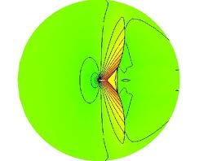
A troublesome case
An airfoil travelling just below the speed ofsound, at a Mach number of 0.95. A very extensive tail shock forms in a “fishtail pattern. This is where all the large gradients are located.
However, these shocks have almost no influence on the airfoil, because they are separated from it by a region of supersonic flow.

Slide 44
Entropy balance
Entropy out -entropy in - entropy created =0
Should always be true. We take the RHS to be our objective function for which the grid is to be optimized. The Lagrange multiplier turns out to be the entropy variables. For an ideal gas these are
Our code uses these variables to weight a measure of the residual. Those cells lying in the top ten percent are refined. Convergence would not be meaningful.

Slide 45
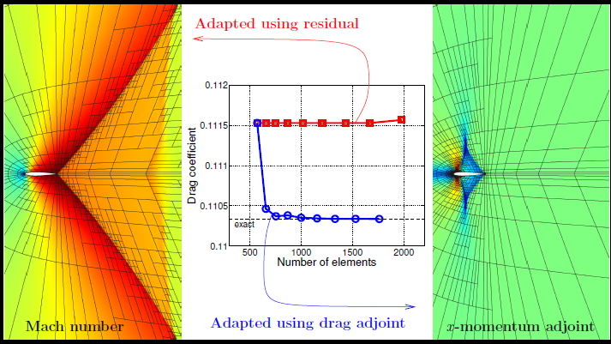
A purpose-filled adaptation
Computation by Prof Krysztof Fidkowski (Michigan)

Slide 46
Modern CFD codes have evolved
Through natural selection. As the environment (design ambitions, available hardware) has changed, some algorithms have died away and others have been born. Evolution works with whatever already exists. Can CFD do better than evolve?

Slide 48
