Slide 1
A third-order active flux scheme
Philip Roe
Department of Aerospace Engineering
University of Michigan
Fortieth Woudschoten Conference on Numerical Analysis
7-9 October, 2015

Slide 2
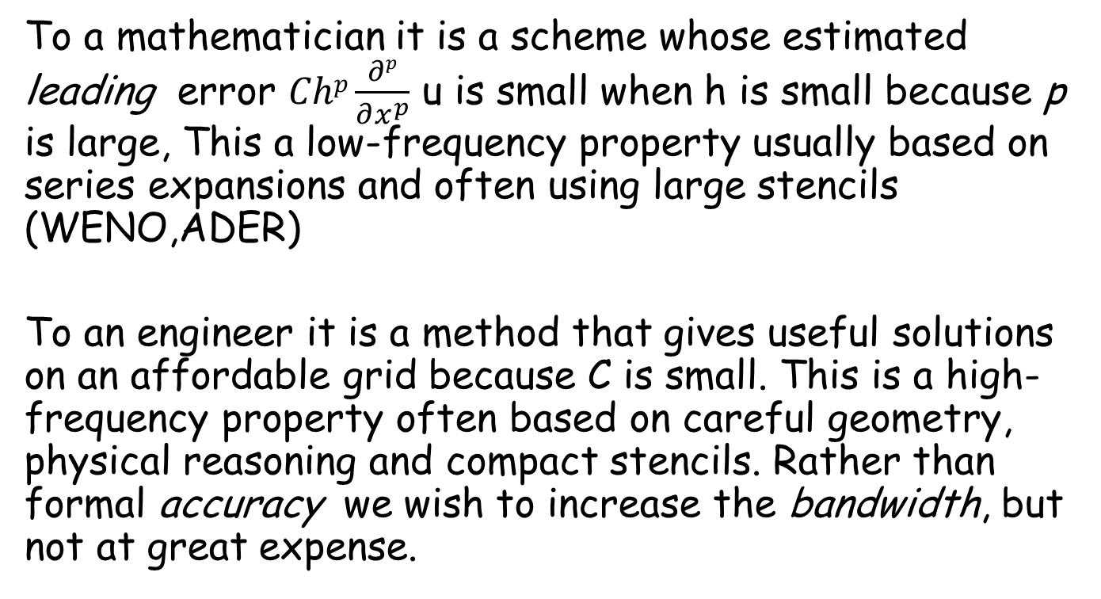
What is “High-order” ?
To a mathematician it is a scheme whose estimated leading error $Chp\frac{∂p}{∂x^{p}}$ u is small when h is small because p is large, This a low-frequency property usually based on series expansions and often using large stencils (WENO,ADER)
To an engineer it is a method that gives useful solutions on an affordable grid because C is small. This is a high-frequency property often based on careful geometry, physical reasoning and compact stencils. Rather than formal accuracy we wish to increase the bandwidth, but not at great expense.

Slide 3
The role of physical reasoning
Has been exemplified by one-dimensional upwinding which causes numerical information to propagate in the same direction as physical information. It brings transformational change to one-dimensional computations.
It is dubious when applied to multidimensional flows whose physical discontinuities do not coincide with element edges. The Riemann problem is introduced to reveal the effect of imaginary discontinuities.
“Multidimensional” methods often rely on a blend of one-dimensional thinking; This may be the first method that starts in three dimensions.

Slide 4
The problem with the ICASE equation
We gained many incredible insights from the analytical study of numerical methods for the linear advection equation,
but we were misled by those successes into thinking that all hyperbolic problems are alike. In one dimension, acoustic waves and advection “waves” behave much alike, but in two/three dimensions they behave quite differently.
advection acoustics
linear domain of dependence isotropic domain of dependence
bounded variation unbounded variation

Slide 5
Do we need discontinuous representations?
Pro
Discontinuities are introduced by geometrical limiting processes.
Discontinuous Galerkin methods have mass matrices that are local, in accordance with the nature of hyperbolic flow.
Con
Discontinuities aligned with cell faces introduce locally one-dimensional physics.
The scaling of pressure disturbances at low Mach number is badly wrong.

Slide 6
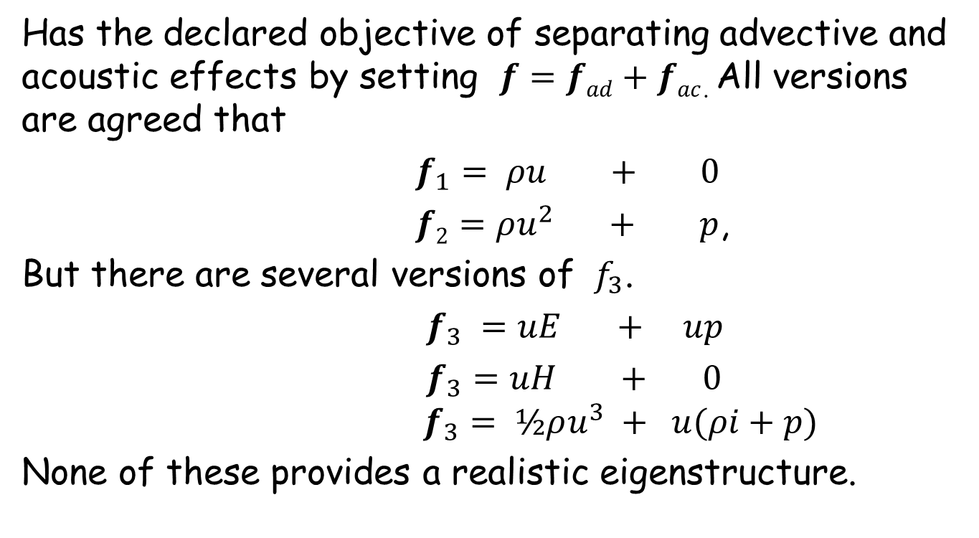
Flux vector splitting
Has the declared objective of separating advective and acoustic effects by setting $f=fad+fac$. All versions are agreed that
$f_{1}= ρu + 0$
$f2=ρu^{2} + p$,
But there are several versions of ${ f}_{3}$.
$f_{3} =uE + up$
$f_{3}=uH + 0$
$f_{3}= ½ρu^{3} + u(ρi+p)$
None of these provides a realistic eigenstructure.

Slide 7
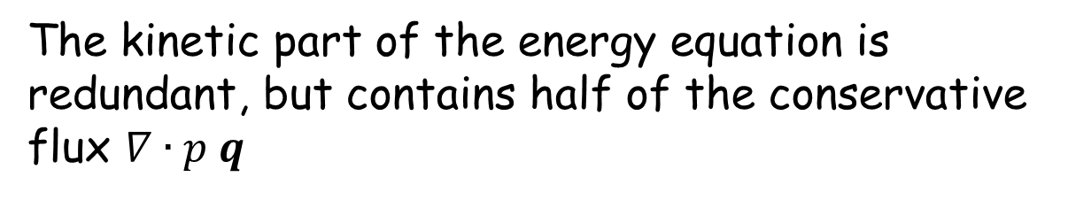
Non-conservative splitting
The kinetic part of the energy equation is redundant, but contains half of the conservative flux $∇∙p q$
The underlined terms describe the acoustic components of the flow

Slide 8
A clear decomposition
My objective is to create a scheme that properly respects this decomposition. I will be content with third-order accuracy (perhaps optimal for typical aerodynamic problems). I will not attempt general hyperbolic problems.

Slide 9
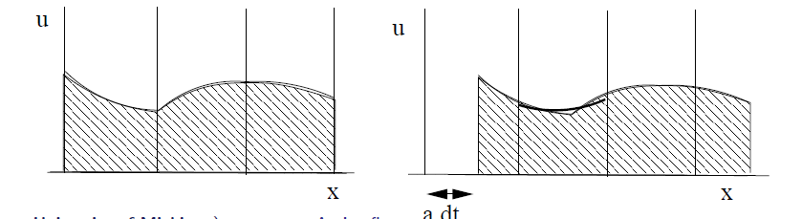
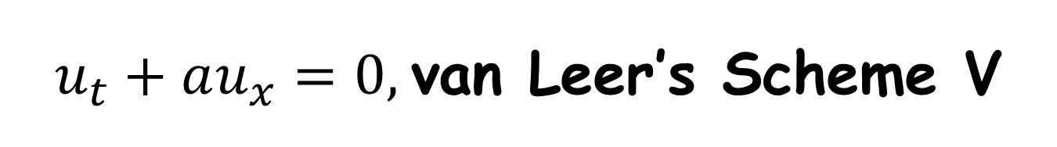
$u_{t}+au_{x}=0,$van Leer’s Scheme V
Taking the degrees of freedom in each cell to be the cell average and point values at each edge, make a continuous quadratic reconstruction. Shift this through a distance aΔt. This is third-order, fully discrete, applicable up to the outflow boundary, and stable up to CFL=1.0. The semidiscrete version is a form of DG1.
B. Van Leer, A new approach to numerical advection, Part IV, JCP, 1977.

Slide 10
Interpretation as characteristic tracing
Given the reconstruction on the left, transfer
data from EFR to E’F’R and integrate using
Simpson’s Rule

Slide 11
Dissipation analysis
0.406
0.00406

Slide 12
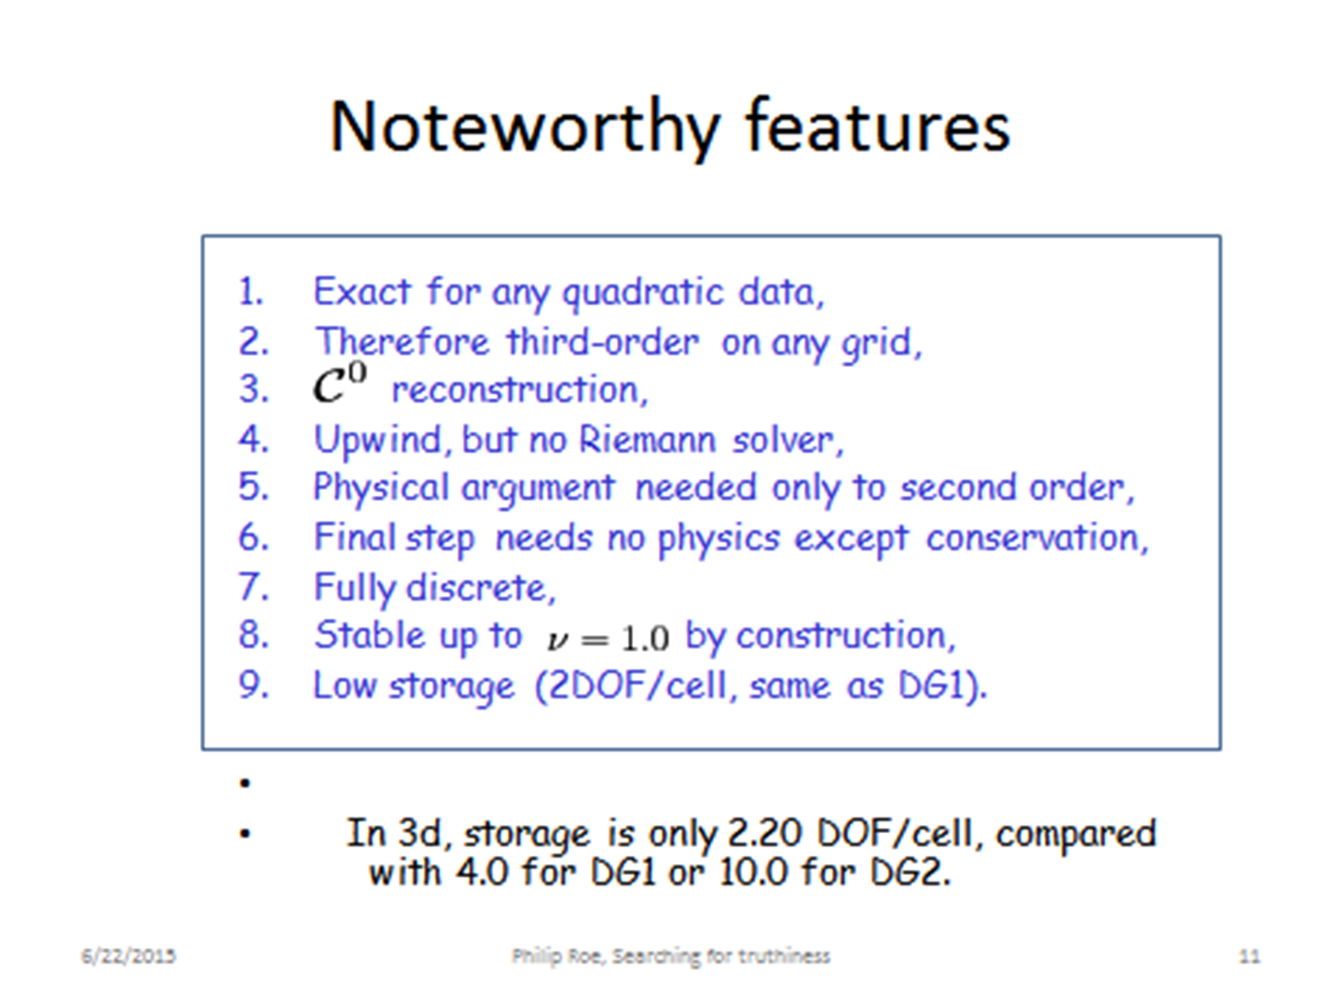

Slide 13
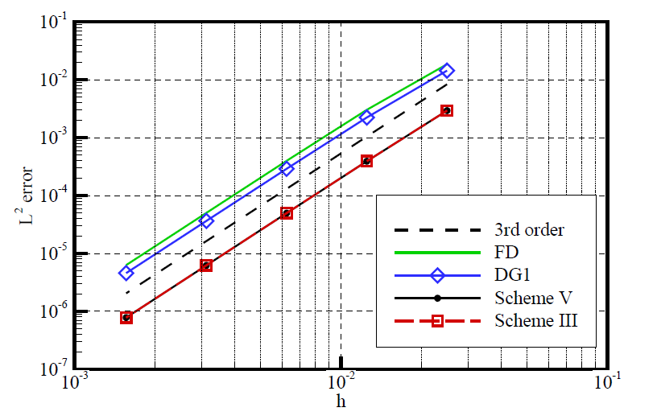
Experiments on a Gaussian profile
To obtain similar accuracy, Scheme V requires three times fewer points, three times fewer timesteps, and 2.5 times fewer operations per time step. (3² x 2.5 ~ 20)

Slide 14
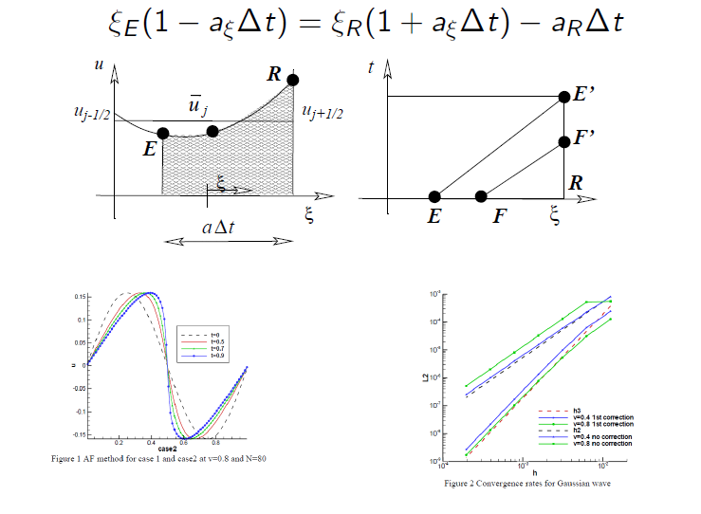

Scalar conservation laws
Need only a first-order correction to the characteristic origin
$ξE=1 −$a_{R}Δt /(1+ ∂ξ a)
Notes:
a

Slide 15
General multidimensional approach to advection
The solution is assumed continuous across boundaries of simplex elements; no Riemann solver.
Most degrees of freedom are assigned to the boundaries and therefore shared among more than one element.
One degree of freedom is assigned to the element average. Polynomial reconstruction.
All values except cell average updated by characteristic tracing for advection terms and by Poisson integrals for acoustic terms.
Cell average is updated from boundary fluxes.
Order of accuracy is p + 1; method is exact on any grid for linear equations if data is globally of the form assumed for the reconstruction.
Method is fully discrete and stable to the maximum physically allowed timestep.

Slide 16
Linear advection in two dimensions
From each boundary point, the characteristic line dx= a Δt is drawn
backward. The new value of u at A is taken from the point a.
The value at Δt/2 is taken from halfway along. Then a Simpsons Rule
integral is made of the flux at that point with respect to time and this
is used to update the cell average.
The integral of the new quadratic
reconstruction is
In general the two cell averages
do not agree and a cubic bubble
function is added to ensure
conservation. In smooth regions
this has a fourth order effect.
I = 𝑆/3 [𝑢_{𝑎}+𝑢_{𝑏}+𝑢_{𝑐}]

Slide 17
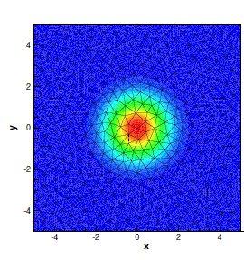
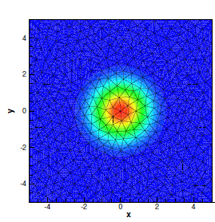
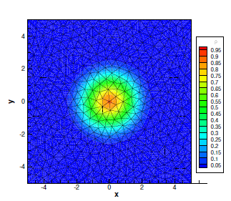
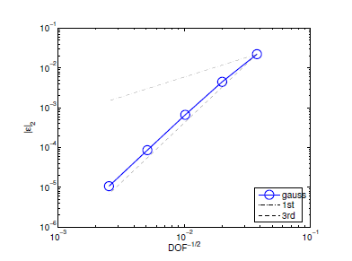
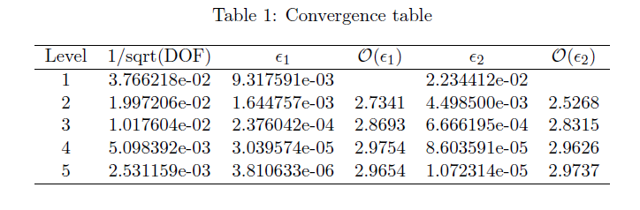
Two-dimensional advection test
Initial data
One circuit
Five circuits
L2 errors after one circuit

Slide 18
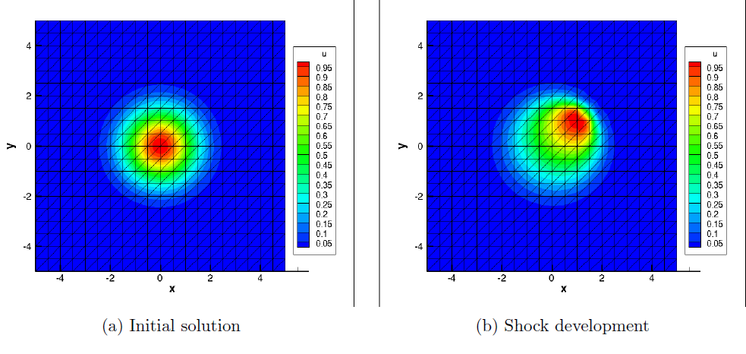

Nonlinear advection
The multidimensional Burgers equation is
$$∂_{t}v+v ∙ ∇ v=0$$
It is dealt with by a small correction to the characteristic origin $Δ x=−v Δt /(1+ ∇⋅v)$

Slide 19
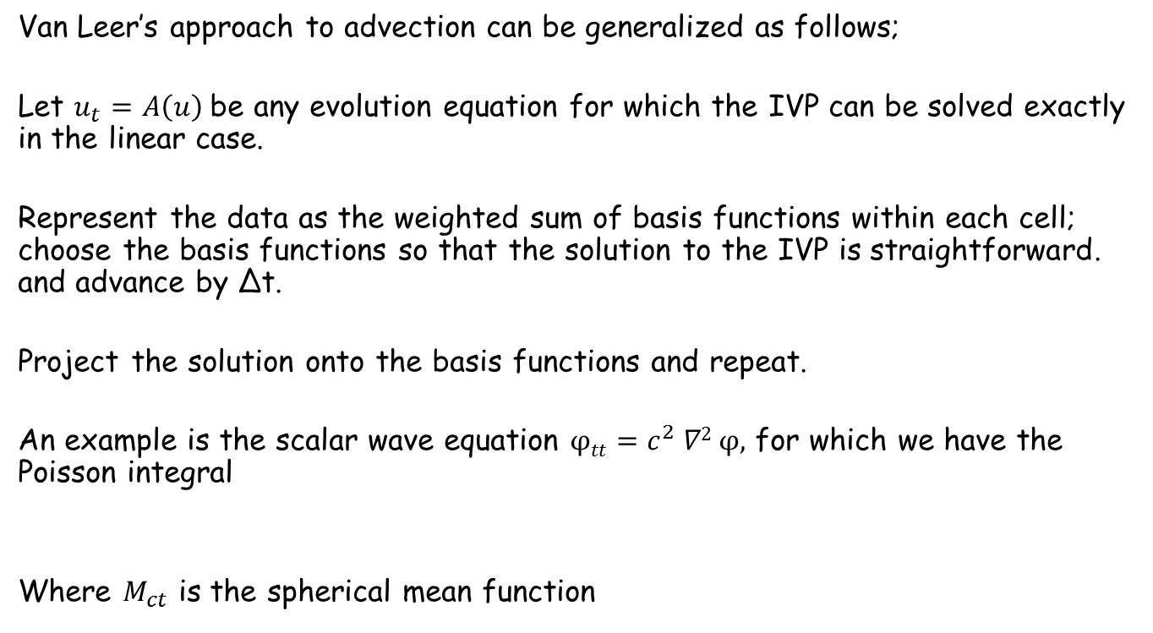
Now for Acoustics
Van Leer’s approach to advection can be generalized as follows;
Let $u_{t}=A\left(u\right)$be any evolution equation for which the IVP can be solved exactly in the linear case.
Represent the data as the weighted sum of basis functions within each cell; choose the basis functions so that the solution to the IVP is straightforward. and advance by Δt.
Project the solution onto the basis functions and repeat.
An example is the scalar wave equation $φtt=c^{2} ∇2 φ,$ for which we have the Poisson integral
Where $M_{ct}$ is the spherical mean function

Slide 20

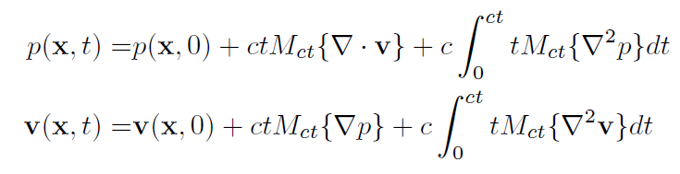
Poisson integral formulas for the acoustic system
This can be directly applied to the pressure in the system wave equation
∂_{t} p + c ∇ ⋅ v = 0, ∂t v + c ∇ p = 0
but not to the velocity components unless the flow is irrotational. A formula that does apply to all variables is
into which the time derivatives can be plugged to yield.

Slide 21

Method of descent
The two dimensional case is handled by considering data for which there is no dependence on one coordinate.
The reconstructed data is integrated over the disc of radius $a∆$t
centered on each boundary point. For stability the disc cannot escape from the union of elements to which the point belongs.

Slide 22
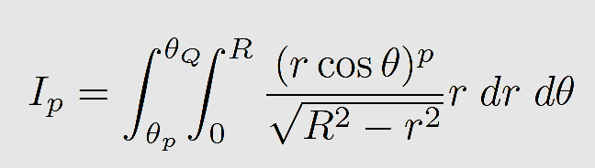
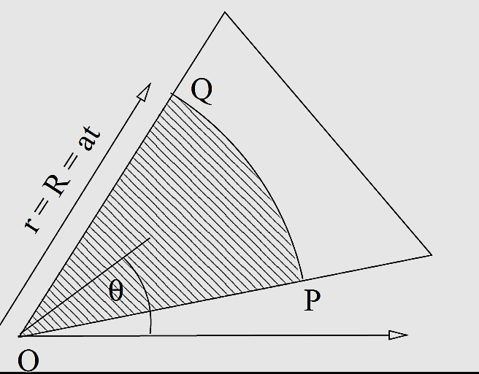
The integrals to be evaluated
are of the form
and those needed for second-order fluxes (third-order schemes) are

Slide 23
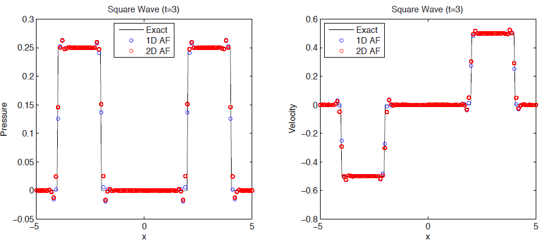
The one-dimensional limit
In one dimension the Poisson solution reduces, as it must, to the method of characteristics. The numerical solutions are not identical because the data structures are not identical
However, they are similar enough that neither one can be preferred.

Slide 24
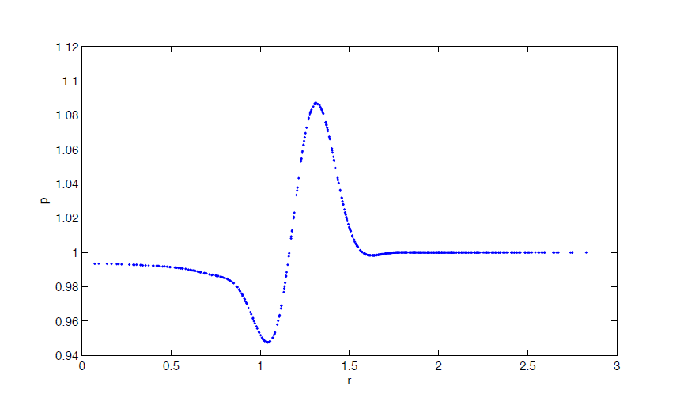
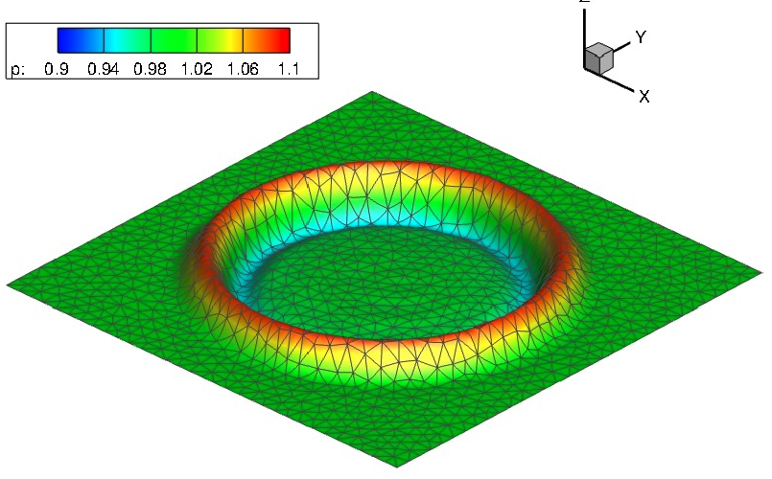
Results for linear acoustics (1)

Slide 25
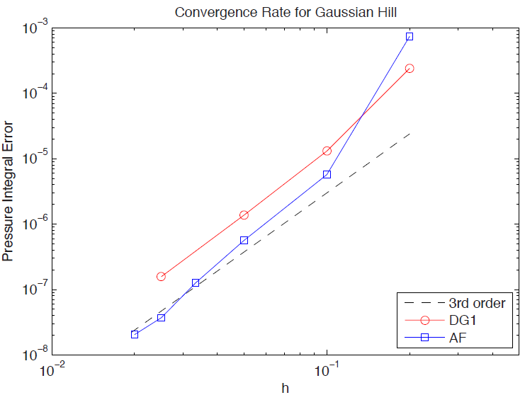
The results are third-order
On this problem the Active Flux method converges at slightly better than third-order. Typically it allows a mesh spacing three times larger than DG1 to achieve a given accuracy. Adding advection by operator-splitting increases the error by about 20%

Slide 26
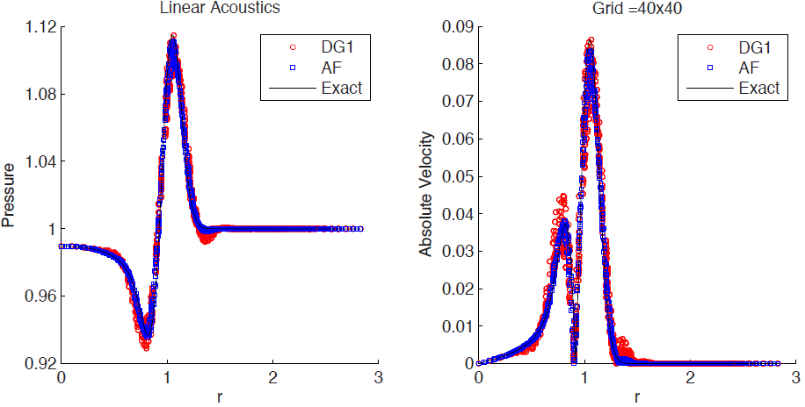
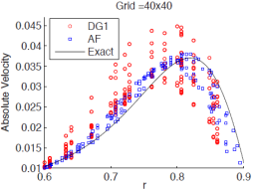
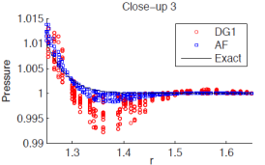
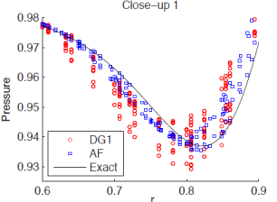
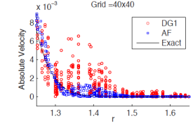
Active Flux results Compared with DG1

Slide 27
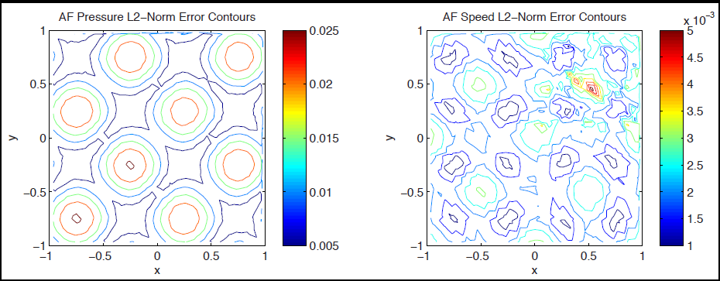
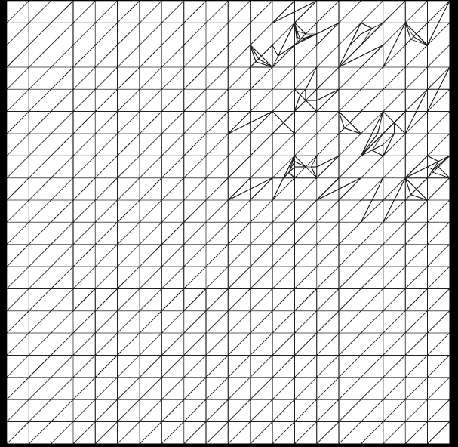
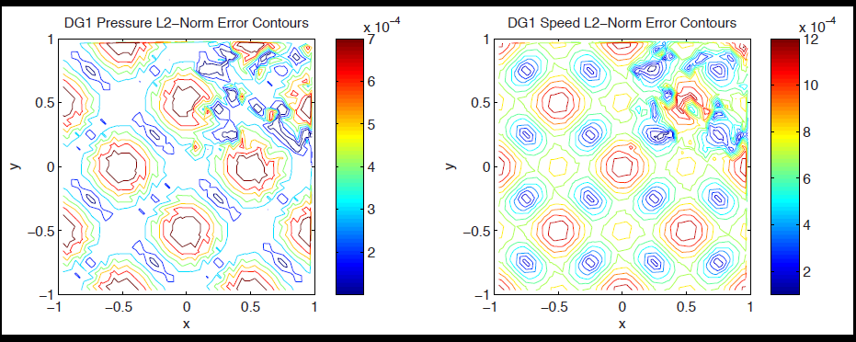
Response to severe mesh distortion
A smooth problem with an analytical
solution
Active flux
DG 1
Distorted grid

Slide 28
In the nonlinear case (Euler equations)
At a linear level the acoustic and advection operators commute but in the nonlinear case operator splitting does not quite work. There are a few interaction terms. However, we have found that a correct evolution can be achieved in three stages
I The inertial stage The equations are solved with the pressure gradients set to zero. To second order there is a simple explicit formula for this.
II. The correction stage. A small correction is made to allow for streamline curvature.
III The acoustic stage. The acoustic effects are added in, as in the linear case with an appropriate linearization.

Slide 29
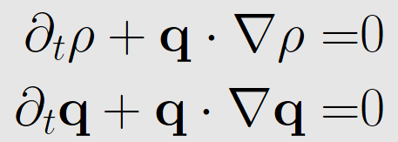
The pressureless Euler equations
represent a cloud of particles travelling independently.
The “momentum” equations have the implicit solution
The particle that will be at x after time Δt is currently at x* where
and the new velocity and density will be

Slide 30
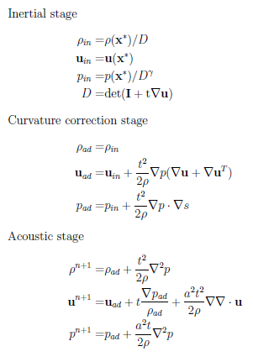
Full update for flux points
This is the complete Lax-Wendroff algorithm for updating the boundary points. The highlighted terms are to be evaluated using the spherical means formulas.

Slide 31
Translation of a vortex through a 10x 10 box
Initial density at O=0.8796
After one circuit =0.8925

Slide 32
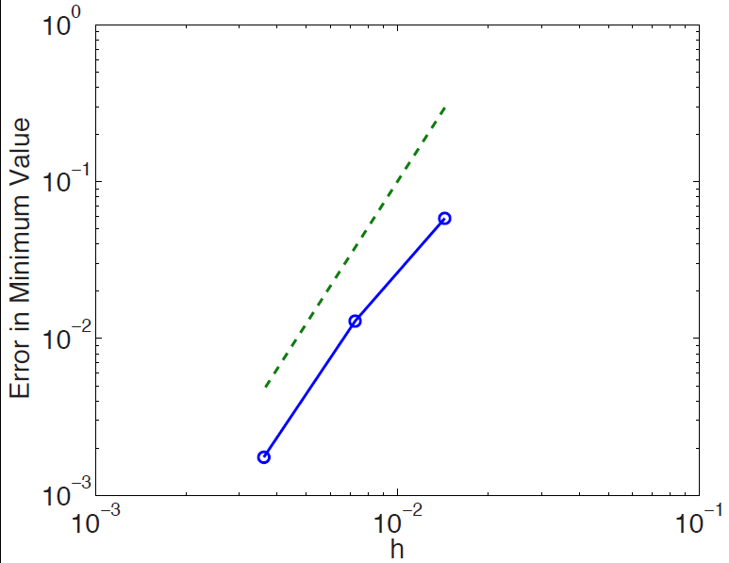
We have third-order convergence!

Slide 33
Summary
A generalization of van Leer’s 1977 “new approach to numerical advection” has been developed to handle either purely advective or purely acoustic problems.
The schemes are third-order in space and time. They are fully discrete, explicit and maximally stable.
The solution to any linear problem is exact for data belonging globally in the approximation space, providing tolerance of poor grids.
Advection and acoustics have been combined for the linear Euler equations with only slight loss of accuracy, and the nonlinear case looks promising.
For given accuracy, the method typically accepts a three times
larger mesh spacing than DG1. If this remains true for nonlinear problems in three dimensions, the saving in operations is a factor of 3⁴ x 2.5 x 3= 603.

Slide 34
Acknowledgements
Timothy B. Eymann, Doreen U. Fan, Brad Maeng,
Ju Wang, Kyle Ding, Prof. Krzystof Fidkowski.
NASA Cooperative Agreement NNX12AJ70A

