Slide 1



Mixed-Integer Optimization
with Constraint Learning
Donato Maragno
University of Amsterdam
Donato Maragno
Holly Wiberg
Dimitris Bertsimas
Dick den Hertog
Ilker Birbil
Adejuyigbe Fajemisin

Slide 2


Diet Problem for WFP

Slide 3



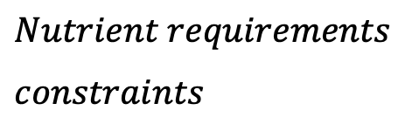


Case Study
Case Study: Diet Problem
Optimize the food baskets delivered by WFP to population groups in need. The objective is to minimize the procurement costs. The set of constraints concerns the nutrient requirements and the food basket palatability.
Energy | Fat | … | Vitamin C
$minimize_{x∈ℝ_{≥0}^{n}} f(x)$
$$Procurement costs$$
$$subject to NutVal_{i}^{T}x≥NutReq_{i} ∀ i∈𝒩$$
$$Nutrient requirements$$
$$constraints$$
$$Palatability\left(x\right)≥t$$
Beans | Fish | … | Oil
$$No explicit formula but data is available$$

Slide 4
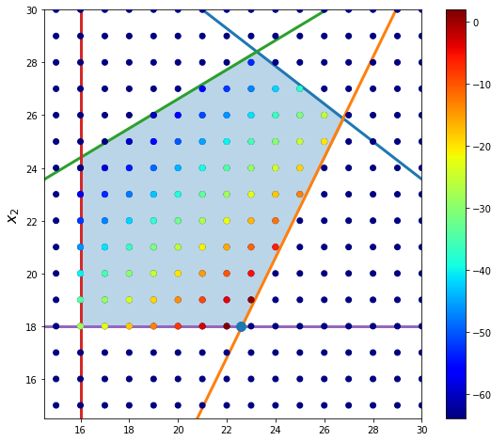
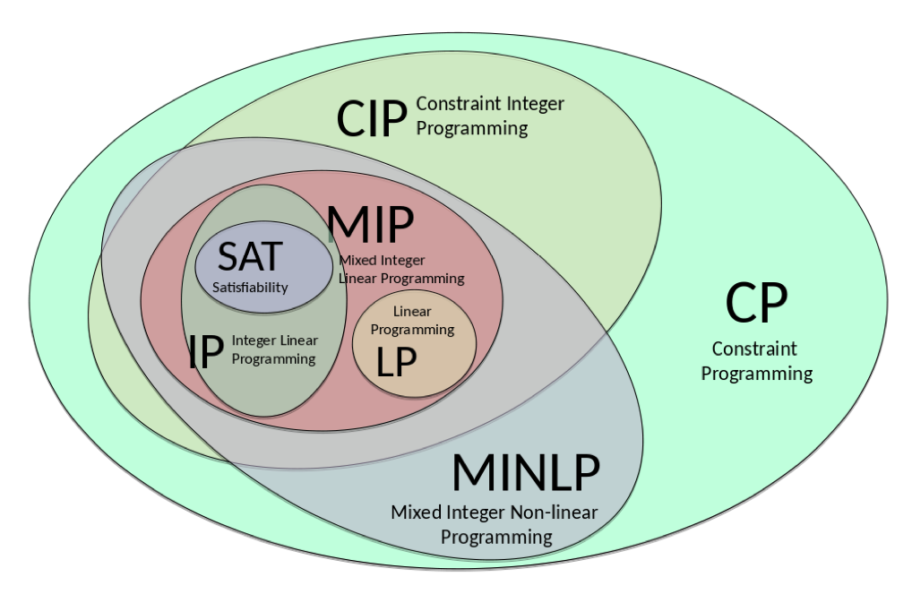
Constraint Learning
Mixed-Integer Optimization (MIO)
Powerful tool that allows us to optimize a given objective subject to various constraints.
Many real-life optimization problems contain one or more constraints or objectives for which there are no explicit formulae.
Machine Learning (ML)
Data is available and machine learning models can be used to learn the constraints.

Slide 5
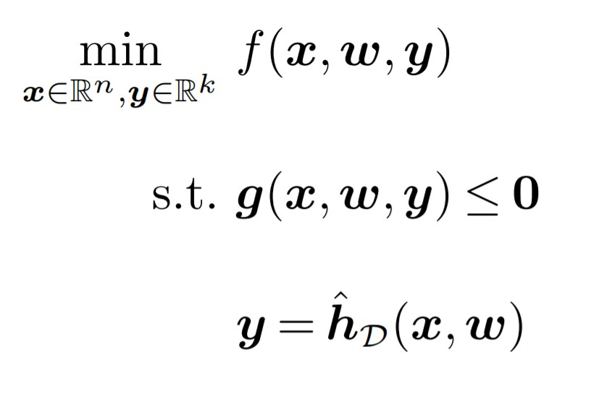
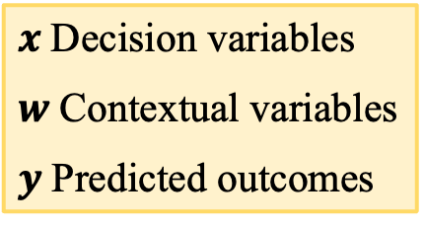

Constraint Learning
Maragno et al. (2021)
$x$Decision variables
$w$Contextual variables
$y$Predicted outcomes
ML Model
$$D={\left\{({\overline{x}}_{i},{\overline{w}}_{i},{\overline{y}}_{i})\right\}}_{i=1}^{N}$$

Slide 6
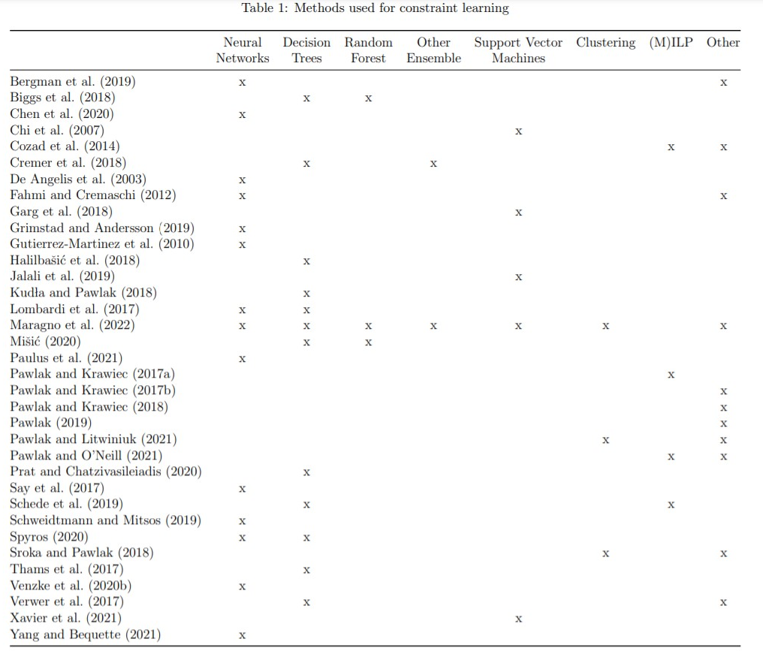
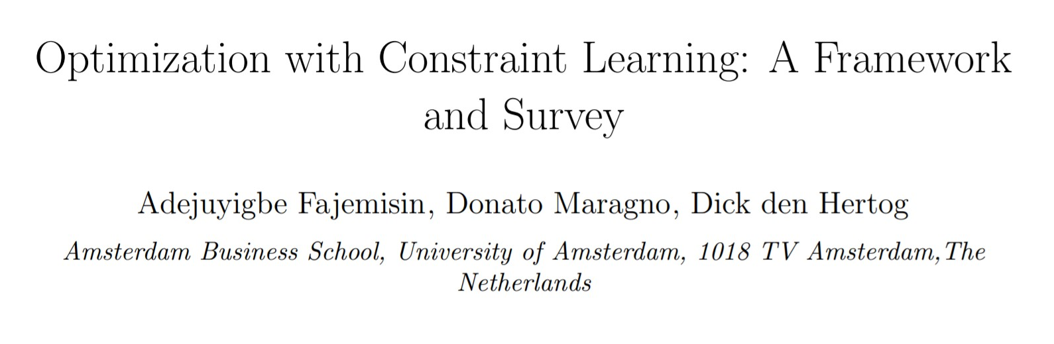
Related Work
Fajemisin et al. (2021)

Slide 7
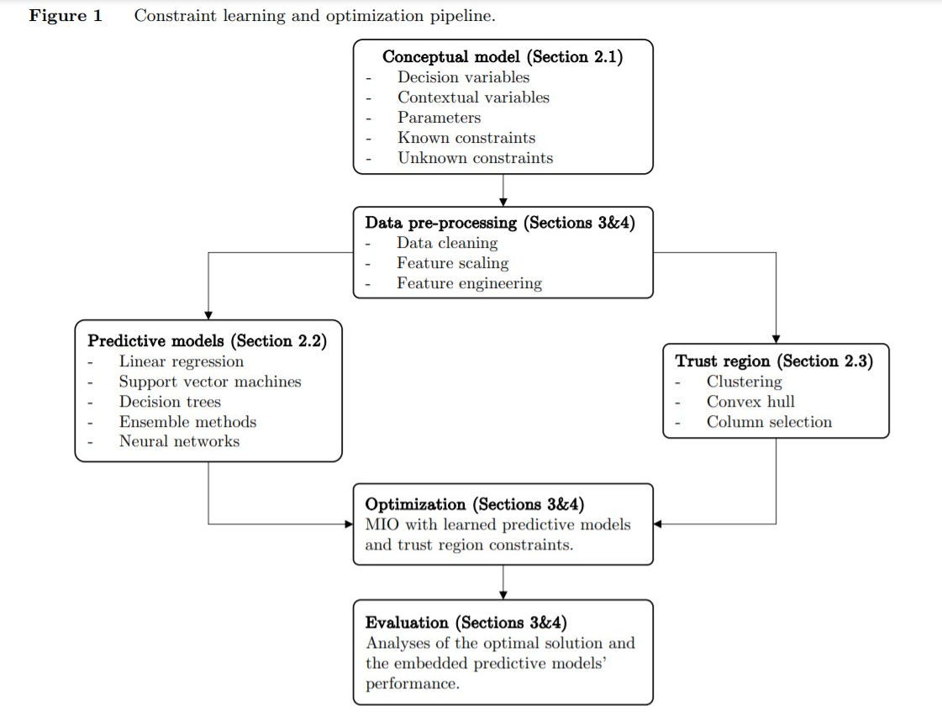
Mixed-Integer Optimization with CL
Maragno et al. (2021)

Slide 8




MIO-representable ML models
ML models
Linear/Logistic Regression
Support Vector Machine
(Optimal) Decision Trees
Random Forest
Gradient Boosting Machines
Neural Networks (ReLU)
$$\min_{x}{ f\left(x\right)}$$
Linear Regression
Conceptual model
ML Model
$$s.t. g\left(x\right)≤0$$
y
$$D={\left\{({\overline{x}}_{i},{\overline{y}}_{i})\right\}}_{i=1}^{N}$$
$${y= β}_{0}+ β^{T}x$$
x

Slide 9

































Decision Trees
$$\min_{x}{ f\left(x\right)}$$
$$\min_{x}{ f\left(x\right)}$$
$$A_{1}^{T}x ≤b_{1}$$
Conceptual model
$$s.t. g\left(x\right)≤0$$
$$A_{1}^{T}x ≤b_{1}$$
$$A_{1}^{T}x ≤b_{1}$$
$$s.t. g\left(x\right)≤0$$
False
$$A_{1}^{T}x ≤b_{1}$$
False
True
False
True
True
$$A_{2}^{T}x ≤b_{2}$$
$$A_{5}^{T}x ≤b_{5}$$
$$A_{2}^{T}x ≤b_{2}$$
$$A_{2}^{T}x ≤b_{2}$$
$$A_{2}^{T}x ≤b_{2}$$
$$A_{5}^{T}x ≤b_{5}$$
$$A_{5}^{T}x ≤b_{5}$$
$$A_{1}^{T}x ≤b_{1}$$
$$P_{3}$$
True
False
True
False
Learned constraints
$$A_{2}^{T}x ≤b_{2}$$
True
True
False
False
True
True
False
False
$$\min_{x}{ f\left(x\right)}$$
$$P_{4}=0$$
$$P_{4}=0$$
$$P_{3}=1$$
$$P_{4}=0$$
$$P_{7}=0$$
$$P_{7}=0$$
$$P_{3}=1$$
$$P_{7}=0$$
$$P_{3}=1$$
$$P_{6}=1$$
$$P_{6}=1$$
$$P_{6}=1$$
$$A_{1}^{T}x≥b_{1}$$
$$P_{6}$$
$$s.t. g\left(x\right)≤0$$
$$A_{5}^{T}x ≤b_{5}$$
$$A_{1}^{T}x≥b_{1}$$
$$A_{5}^{T}x ≤b_{5}$$

Slide 10



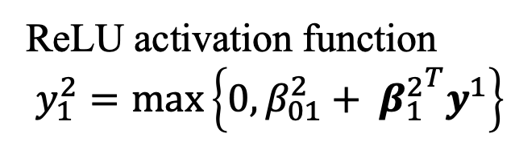
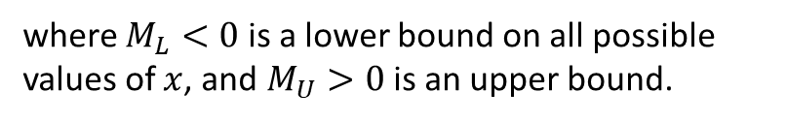




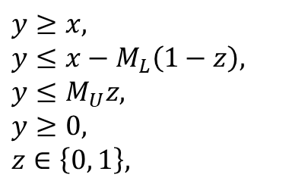









Neural Networks
ReLU activation function
$$y_{1}^{2}=\max\left\{0,β_{01}^{2}+ {β_{1}^{2}}^{T}y^{1}\right\}$$
$$β_{01}^{2}$$
$$y_{2}^{1}$$
$$β_{11}^{2}$$
$$y_{2}^{1}$$
$$y_{1}^{2}$$
$$x_{1}$$
$$y_{1}^{2}$$
$$x_{1}$$
$y=\max\left\{0,x\right\}$ can also be written as:
$$β_{21}^{2}$$
$$y≥x,$$
$$y≤x−M_{L}\left(1−z\right),$$
$$y≤M_{U}z,$$
$$y≥0,$$
$$z∈\left\{0, 1\right\},$$
$$y_{2}^{1}$$
$$y_{2}^{1}$$
$$y_{2}^{2}$$
$$y_{2}^{2}$$
$$Σ$$
$$x_{2}$$
$$Σ$$
$$x_{2}$$
$$β_{31}^{2}$$
$$y_{3}^{1}$$
$$y_{3}^{1}$$
$$y_{3}^{2}$$
$$x_{n}$$
$$y_{3}^{2}$$
$$x_{n}$$
where $M_{L}<0$ is a lower bound on all possible values of $x$, and $M_{U}>0$ is an upper bound.

Slide 11
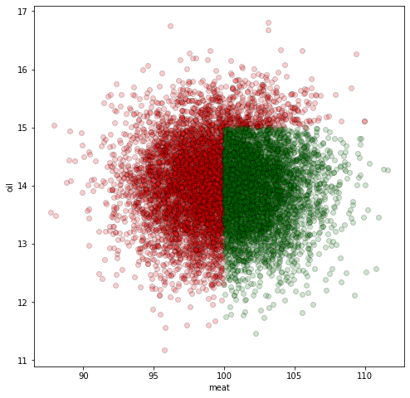
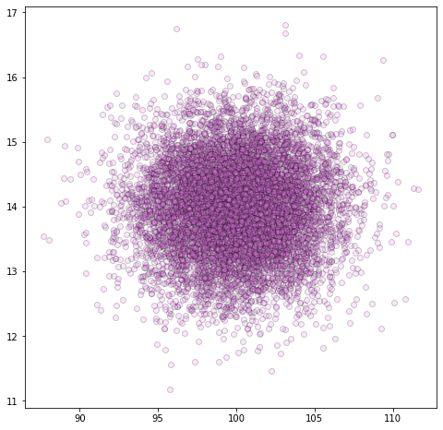
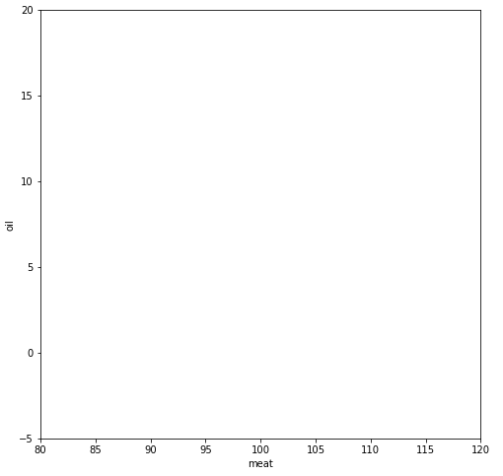
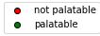
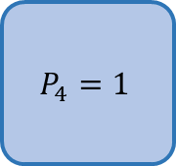
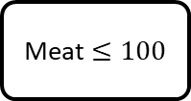
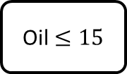
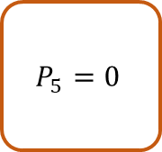
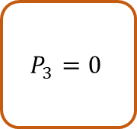
Trust Region
Oil $≤15$
True
False
Meat $≤100$
$$P_{5}=0$$
Objective function
True
False
Objective function
$$P_{3}=0$$
$$P_{4}=1$$
Is it really palatable?

Slide 12
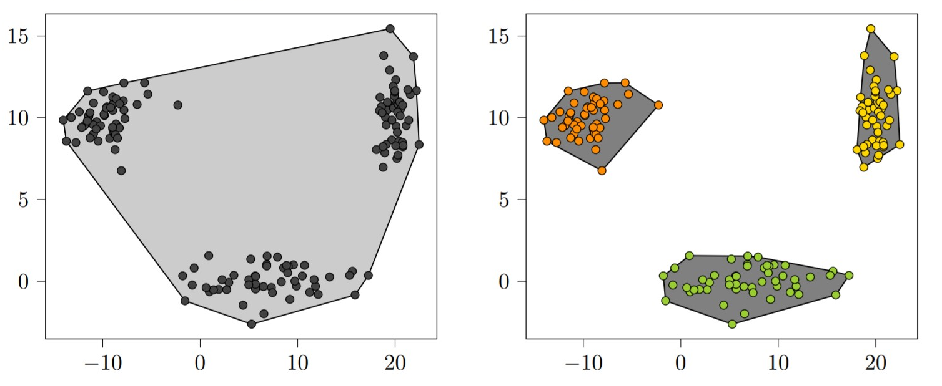
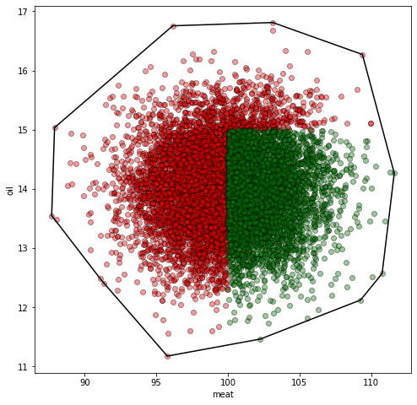
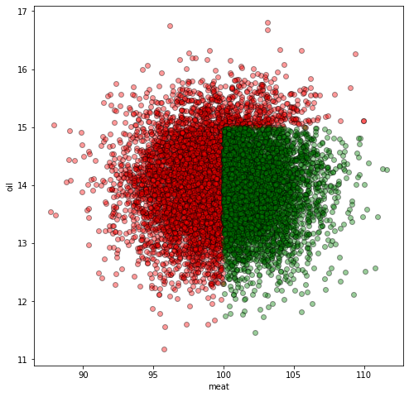
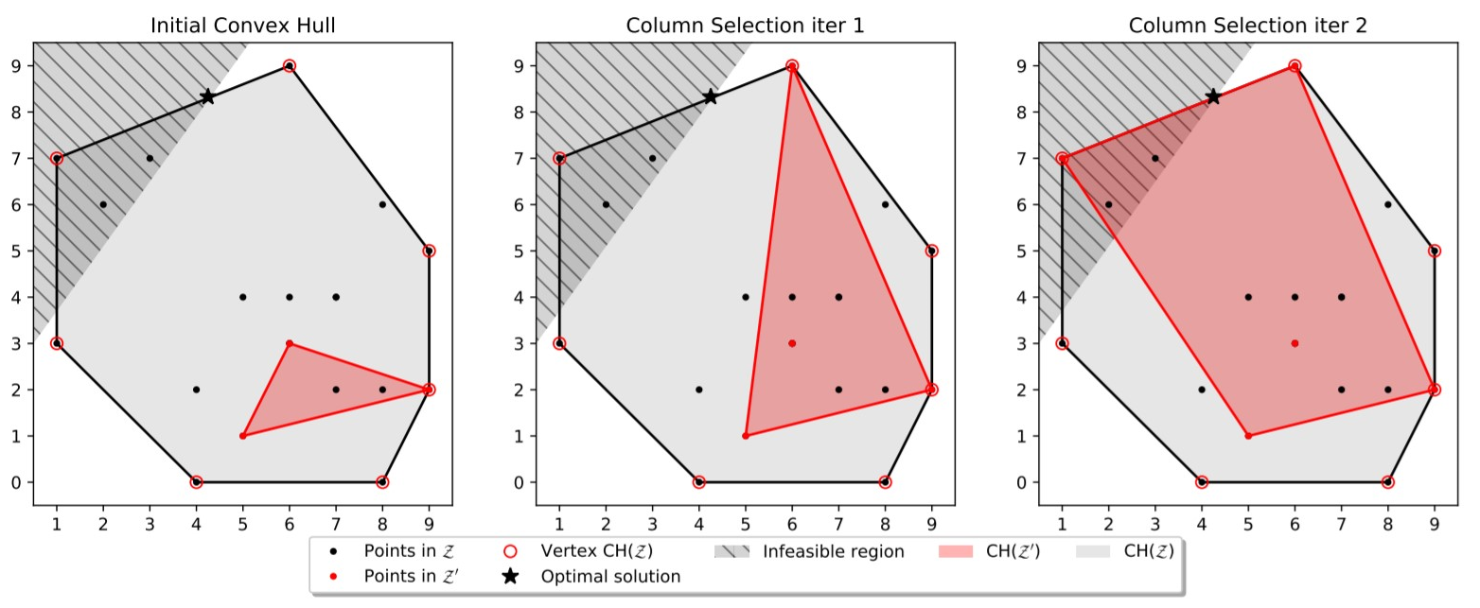

Trust Region
Clustering
Trust region constraints
palatability constraints
palatability constraints
Trust region constraints
$$x=\sum_{i}^{N}{λ_{i}{\overline{x}}_{i}}$$
$$\sum_{i}^{N}{λ_{i}=1}$$
$$λ_{i}≥0, i=1,…, N$$
Other Constraints
Other Constraints
Column Selection Algorithm

Slide 13



OptiCL:
A Python Package for Optimization with Constraint Learning
Codes and Examples
https://github.com/hwiberg/OptiCL

Slide 14
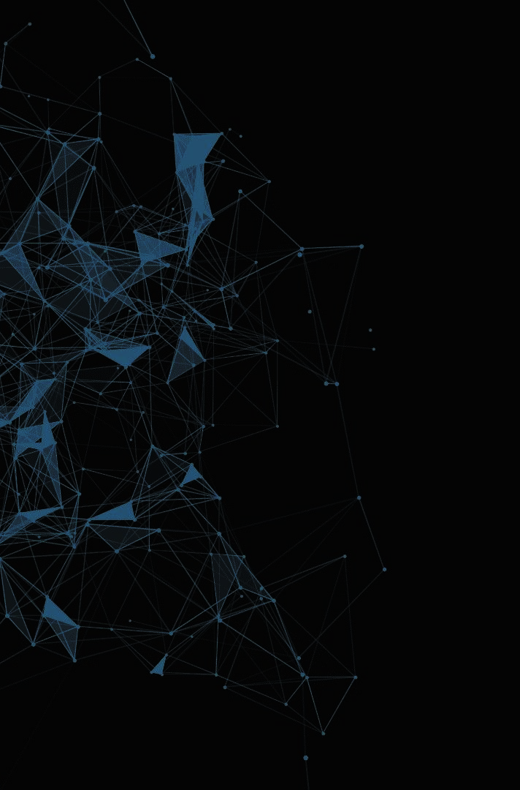
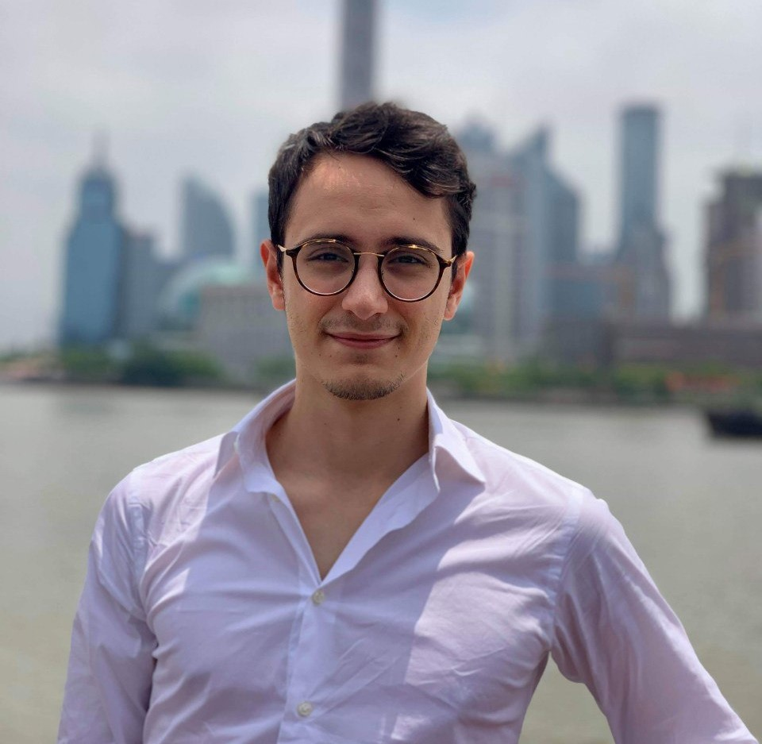




Thank you!
CONTACT ME
d.maragno@uva.nl
github.com/donato-maragno
@MaragnoDonato
linkedin.com/in/donato-maragno

