Slide 1

ABC-EU-XVA
Graziana Colonna - January 21st, 2021
Notes:
Good morning everybody. Thanks for giving me the possibility to be here today and to work with you on this important project.

Slide 2
The Multi-Level Monte Carlo finite element method for XVA in European options: a hybrid approach.
Graziana Colonna

Slide 3
Table of contents
The model
Introduction
The algorithm
Some numerical results
Graziana Colonna

Slide 4
Introduction
Many papers, books develop techniques for valuation of derivatives and derivative portfolios under bilateral counterparty risk.
For instance:
PDE representations of derivatives with bilateral counterparty risk and funding costs by C. Burgard, M. Kjaer
CVA, FVA (and DVA?) with stochastic spreads. A feasible replication approach under realistic assumptions by L. Manuel, G. Muñoz
In common, all of these works have that, in order to calculate the derivative value, a PDE needs to be solved. Alternatively, an expected value has to be computed.
The dimension of the PDE depends on the number of stochastic market variables involved in the model.
Graziana Colonna

Slide 5
Introduction
Thus, on one side, we face the notoriously difficult problem known as the "curse of dimensionality”.
On the other side, Monte Carlo methods, are often appreciated due to their flexibility and applicability in high dimensions. However, a high level of accuracy can be computationally onerous to achieve.
The idea of this work is to mix these two instruments, exploiting the power of Monte Carlo methods and the preciseness of a PDE solution.
Graziana Colonna

Slide 6
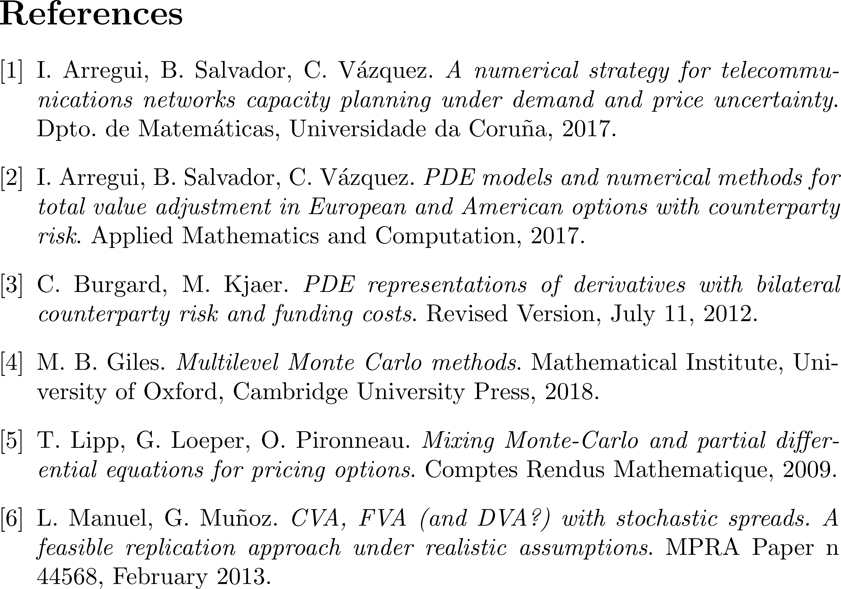
Introduction
Graziana Colonna

Slide 7
Introduction
Graziana Colonna

Slide 8
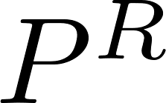

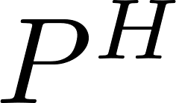
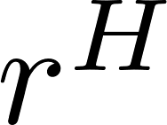
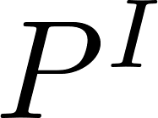
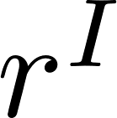

The Model
We start from a work of C. Burgard and M. Kjaer, where, using hedging arguments, they derive two PDEs, one linear and one nonlinear, in order to estimate the value of a risky derivative between two defaultable parties, the Hedger, H, and the Investor, I.
They consider a portfolio with four traded assets:
: default risk-free, zero-coupon bond, with yield ;
: default risky, zero-recovery, zero-coupon bond of party H, with yield ;
: default risky, zero-recovery, zero-coupon bond of party I, with yield ;
: underlying asset with no default risk.
Graziana Colonna

Slide 9
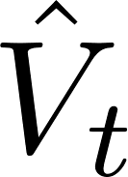
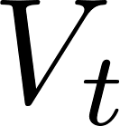
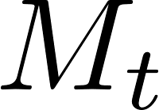
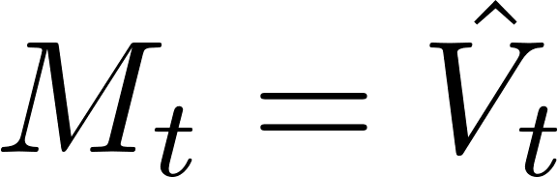
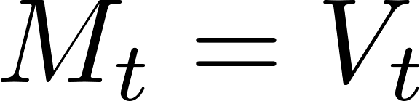
The Model
We refer to the value of the risky derivative as . Similarly, let denote the
value of the same derivative when the two parties cannot default (risk free derivative).
The mark-to-market value of the derivative at default of either the counterparty or the hedger, denoted by , can be:
, the mark-to-market value of the derivative at default is equal to the value of the risky derivative;
, the mark-to-market value of the derivative at default is equal to the value of the risk free derivative.
Graziana Colonna

Slide 10
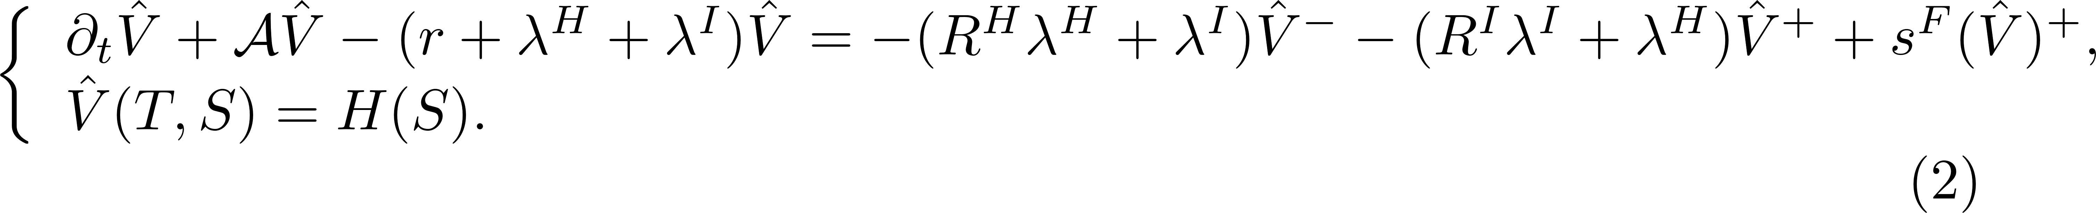
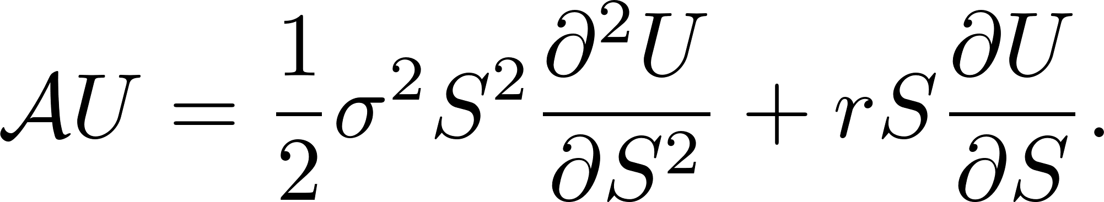
The Model
By using replication arguments and including funding costs, they derive the following two
PDEs:
Non Linear PDE ( ):
Linear PDE ( ):
Graziana Colonna

Slide 11
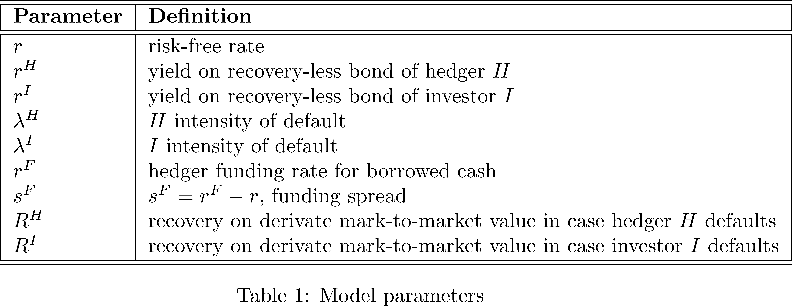
The Model

Slide 12
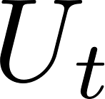
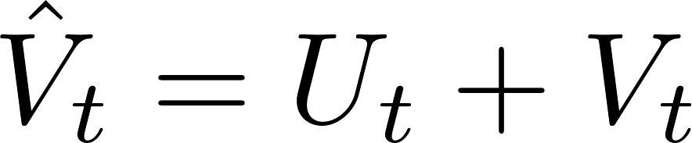
The Model
Since our aim is the computation of the total value adjustment, we can write the risky value of the derivative as the sum of the risk-free value and the value adjustment, ,
i.e. .
The value of the risk-free derivative satisfies the Black-Scholes equation. The we have:
Non Linear PDE:
Linear PDE:
Graziana Colonna

Slide 13
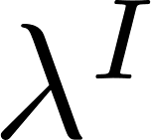
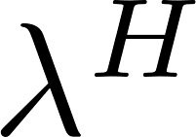
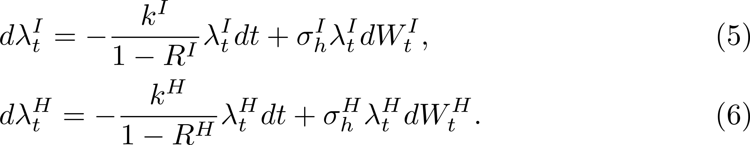
The Model
Let's suppose now that the intensities of default of both the investor and the hedger, and , are no longer constant, but stochastic.
In order to do this, we add to the market assumptions a Credit Default Swap (CDS) curve for the investor and for the hedger.
The two SDEs that govern the intensities of default and are:
Graziana Colonna

Slide 14
The Model
At this point, having the stochastic equations of and specified, our aim is to solve the PDEs defined by (3) and (4) considering and stochastic.
We are going to compute the expected value of the unknown U of the PDE, mixing a finite element method with a Monte Carlo simulation.
Graziana Colonna

Slide 15
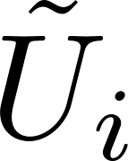
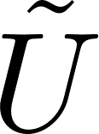
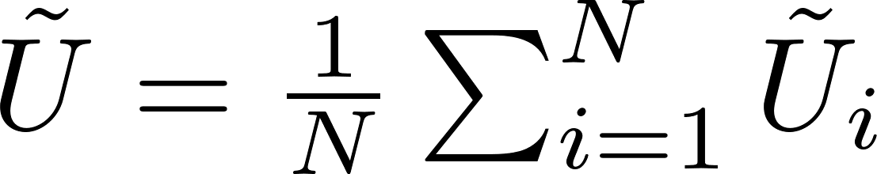
The Algorithm
Main idea of the algorithm: compute the solution of the PDE N different times, one for each independent Monte Carlo path of and . Let’s denote the solution of the PDE as .
The final solution of the model is:
In order to obtain a convergence acceleration, we used the Multi Level Monte Carlo method.
Graziana Colonna

Slide 16
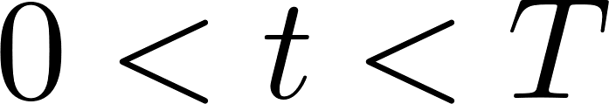
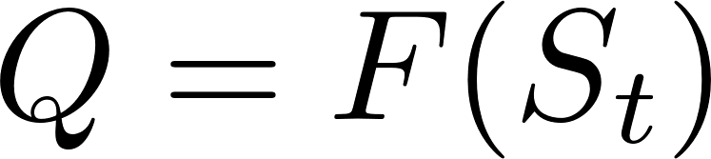

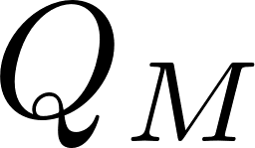

The Algorithm
Multi Level Monte Carlo (MLMC) method:
It is used to compute the expected value of a quantity that is a functional F of the solution of a SDE.
Key concept of MLMC:
We sample not just from one approximation of , but from several, on different discretizations of the time interval [0,T].
Graziana Colonna

Slide 17
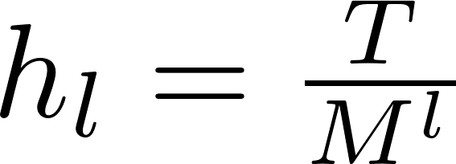
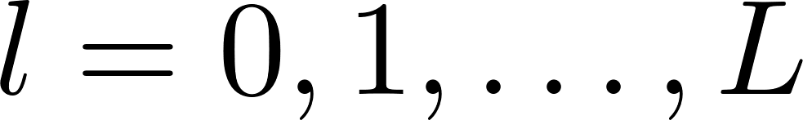
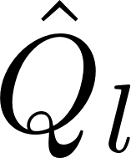
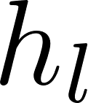
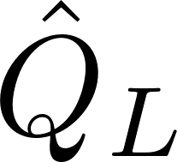
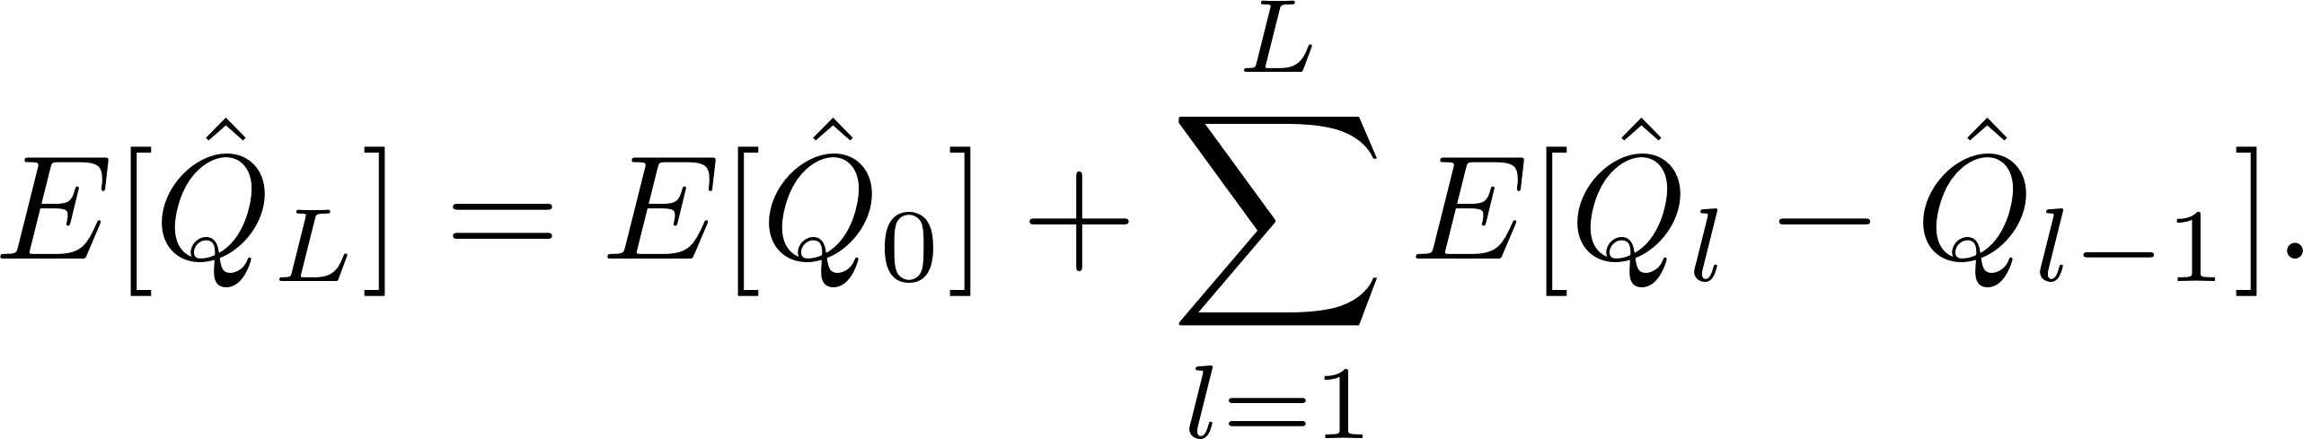
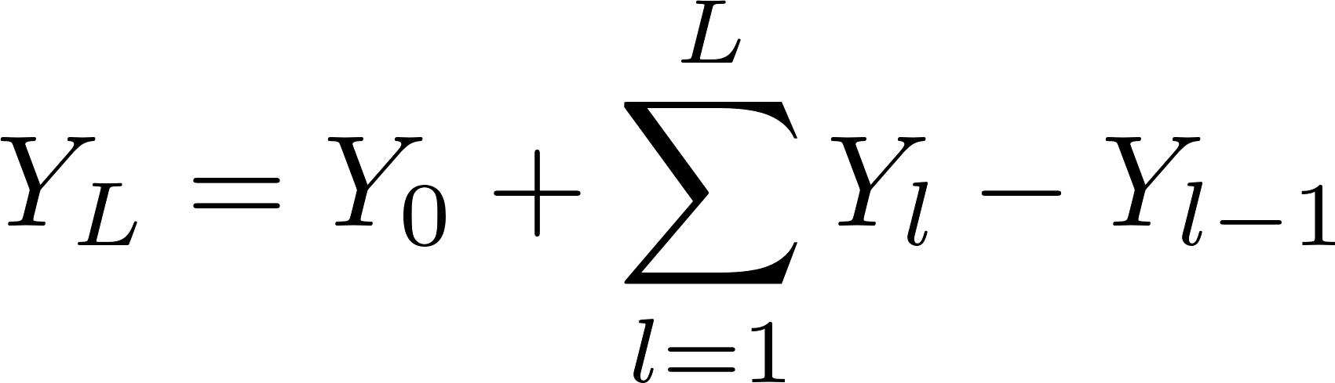
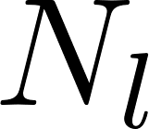
The Algorithm
Multi Level Monte Carlo (MLMC) method:
Let's consider a fixed natural number M>0, a timestep , with and let's denote with an approximation of , estimated on the discretisation of the time interval with the timestep .
We can say that the expected value of is
We can approximate each of this quantities using the Monte Carlo method, with simulations.
Graziana Colonna

Slide 18
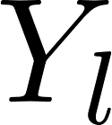
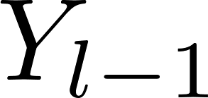
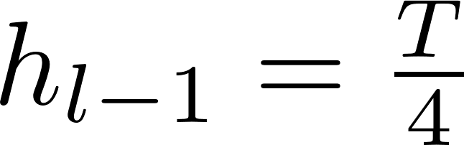
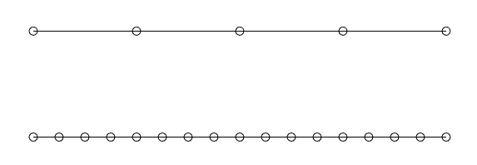
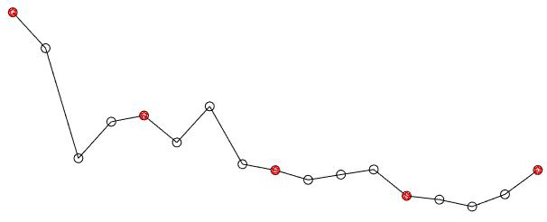
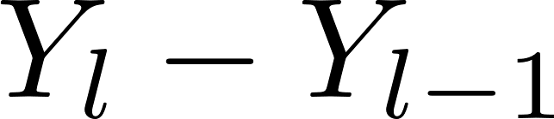
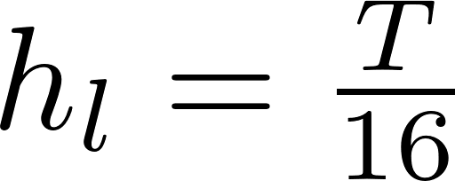
The Algorithm
Multi Level Monte Carlo (MLMC) method:
What we have to stress is that and come from two discrete approximations with different timesteps but that share the same Brownian path.
0
T
This means that, in order to compute
it is sufficient to simulate
on the finer discretisation and
extrapolate the thicker discretisation.
0
T
Graziana Colonna

Slide 19
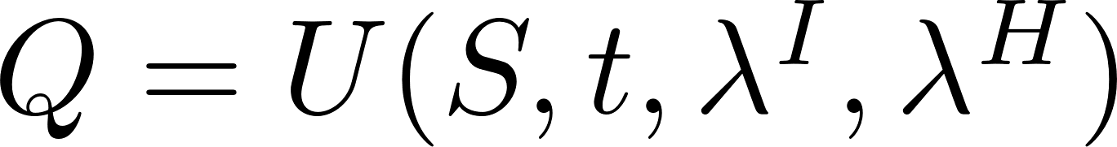
The Algorithm
Going back to our initial problem:
Graziana Colonna

Slide 20
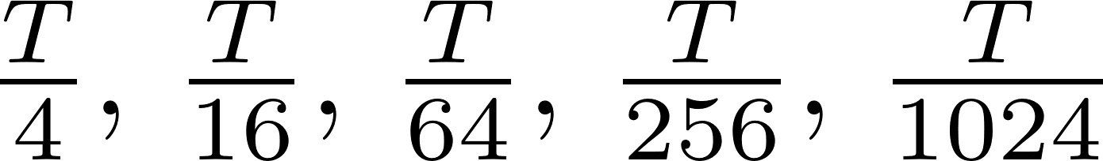
Numerical Results
We present a graphic of the error of the solution computed with MLMC against the error
of the solution computed with MC.
For the MLMC we used 500 samples per level, for the MC we used 1000 samples. In both the cases, the spatial interval is discretised into 1000 nodes.
We show the error versus the time step that, for both MLMC (in the highest level of resolution) and MC, varies between .
Graziana Colonna

Slide 21
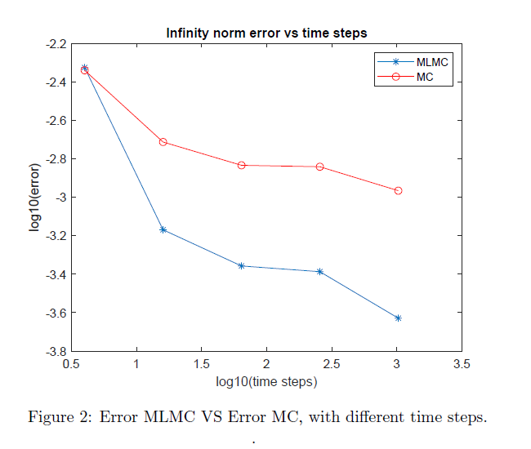
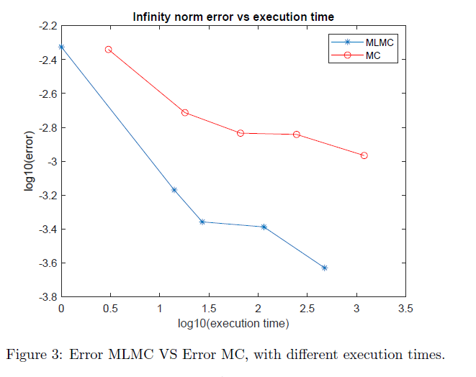
Numerical Results
Time step varies between .
Graziana Colonna

Slide 22
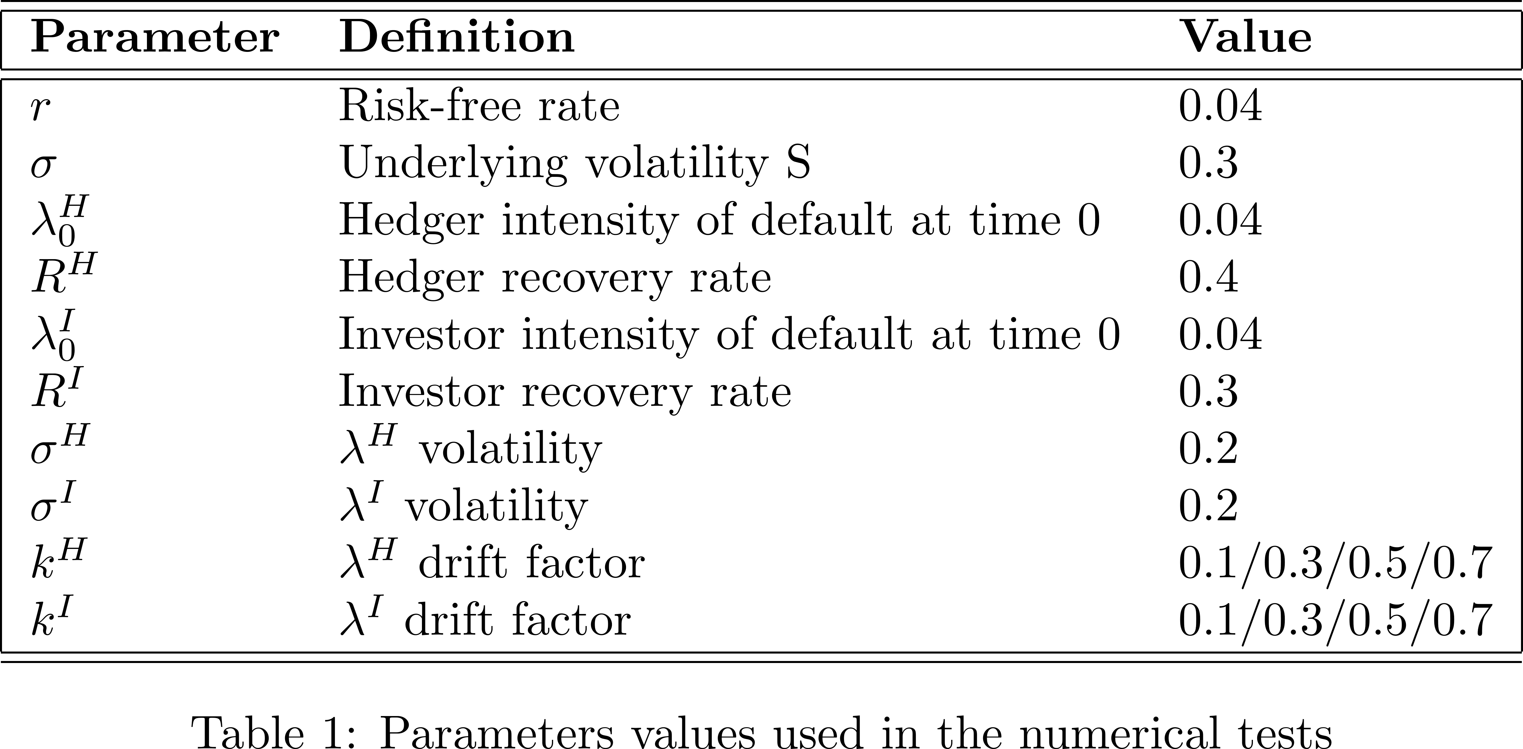
Numerical Results
The derivative taken into account in our numerical examples, is a European put option, with maturity T = 0.5 and strike K = 2. The initial time is always set to zero.
For the finite element mesh, we considered a uniform mesh of 1000 nodes for the spatial discretisation, an initial step M = 4 and 5 levels for the Multi Level Monte Carlo method.
The number of simulation is set to 500 for each level.
Graziana Colonna

Slide 23
Numerical Results
To evaluate the correctness and the consistency of the results obtained, we compared them to the results obtained in I. Arrequi, B. Salvador, C. Vázquez - “PDE models and numerical methods for total value adjustment in European and American options with counterparty risk”, where the author solves the same PDEs, but with and constant (reference solution).
We distinguished three different cases:
Null and Stochastic versus null and constant;
Stochastic and Stochastic versus and constant;
We computed the solution of the hybrid model for 4 different values of the drift term of and .
Graziana Colonna

Slide 24
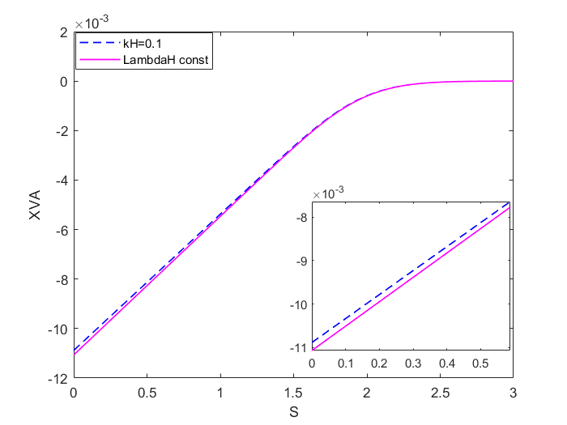
Numerical Results
Time t is 0
One stochastic asset model versus hybrid model, LambdaI null and LambdaH not null.
Graziana Colonna

Slide 25
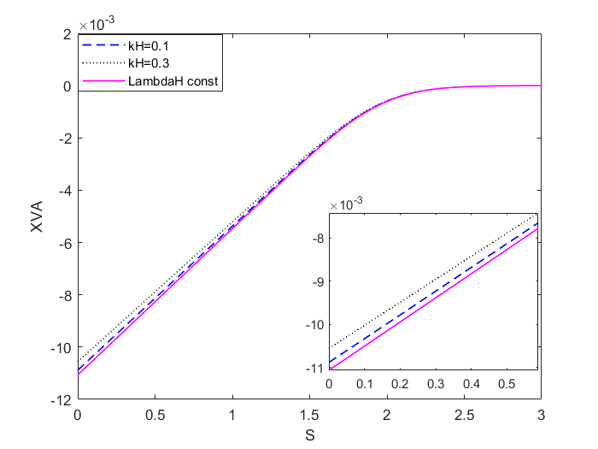
Numerical Results
Time t is 0
One stochastic asset model versus hybrid model, LambdaI null and LambdaH not null.
Graziana Colonna

Slide 26
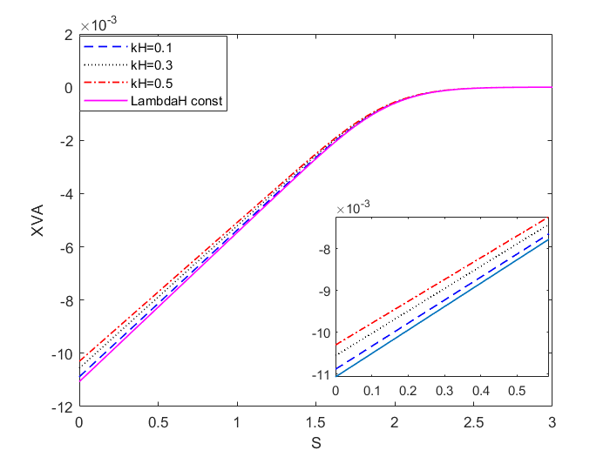
Numerical Results
Time t is 0
One stochastic asset model versus hybrid model, LambdaI null and LambdaH not null.
Graziana Colonna

Slide 27
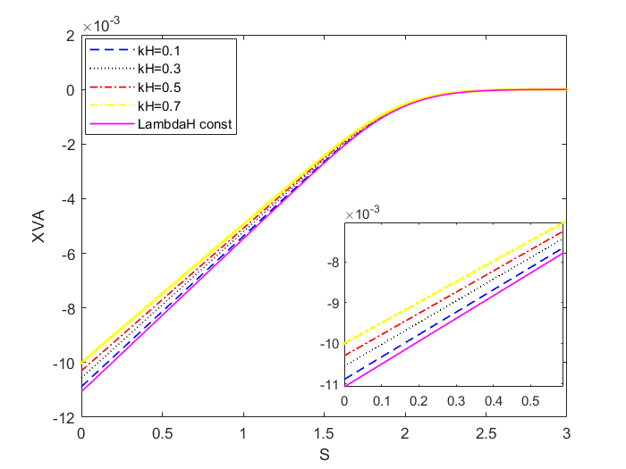
Numerical Results
Time t is 0
One stochastic asset model versus hybrid model, LambdaI null and LambdaH not null.
Graziana Colonna

Slide 28
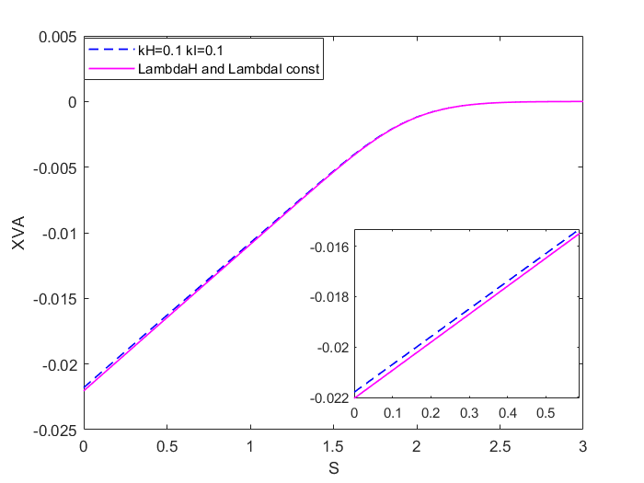
Numerical Results
Time t is 0
One stochastic asset model versus hybrid model, LambdaI and LambdaH not null.
Graziana Colonna

Slide 29

Numerical Results
Time t is 0
One stochastic asset model versus hybrid model, LambdaI and LambdaH not null.
Graziana Colonna

Slide 30

Numerical Results
Time t is 0
One stochastic asset model versus hybrid model, LambdaI and LambdaH not null.
Graziana Colonna

Slide 31

Numerical Results
Time t is 0
One stochastic asset model versus hybrid model, LambdaI and LambdaH not null.
Graziana Colonna

Slide 32
Conclusions and future works
The results that we got are coherent to what we expected.
This kind of algorithm can be applied to any other model.
The idea is to compare the results that we got, to a model in which the intensities of default are taken as
stochastic from the “beginning”.
Graziana Colonna

Slide 33
Thank you
ABC-EU-XVA – Graziana Colonna – January 21st, 2021
Notes:
Good morning everybody. Thanks for giving me the possibility to be here today and to work with you on this important project.

Slide 34













The Algorithm
Graziana Colonna

